Slide 1
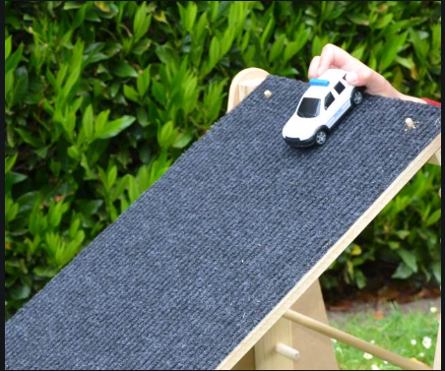
WALT: Explain how to objects move on different surfaces.

Slide 2
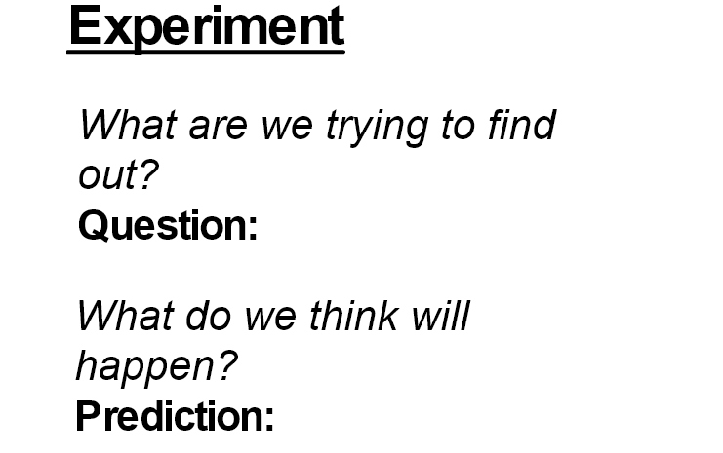
How do objects move differently on different surfaces?

Slide 3
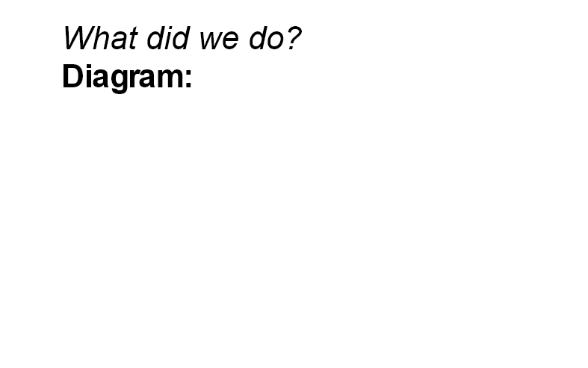
Results:
SURFACE MATERIAL | DISTANCE (m and cm) | NOTES
Fake grass
Bubble wrap
Cardboard
Bench

Slide 4


