Slide 1
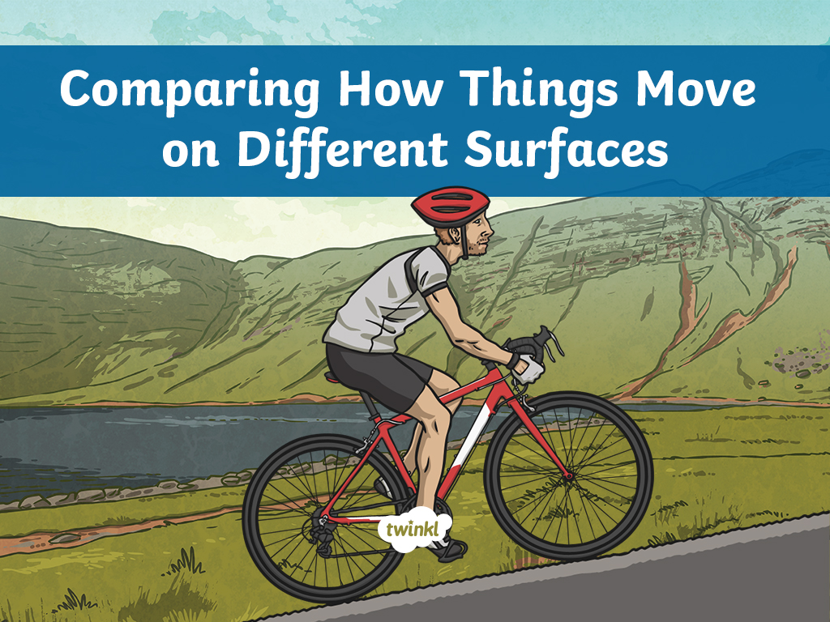

Slide 2
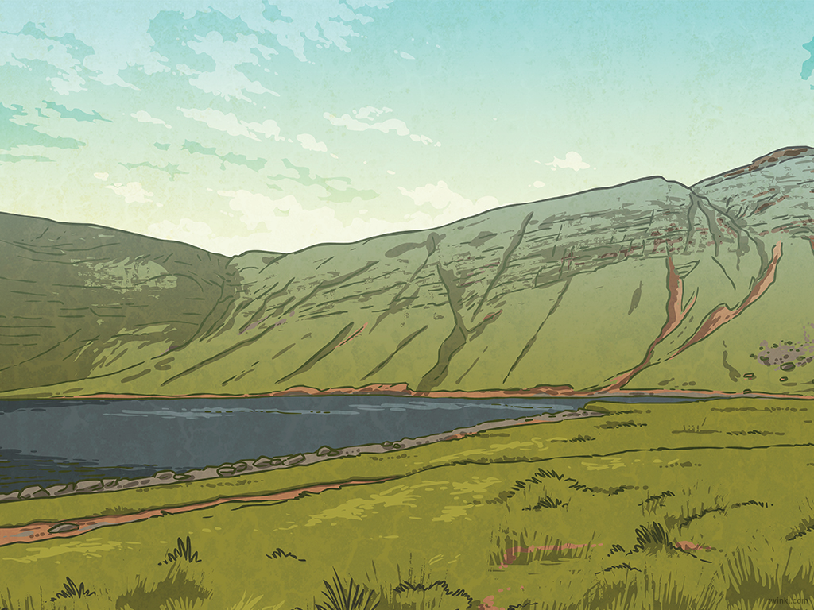
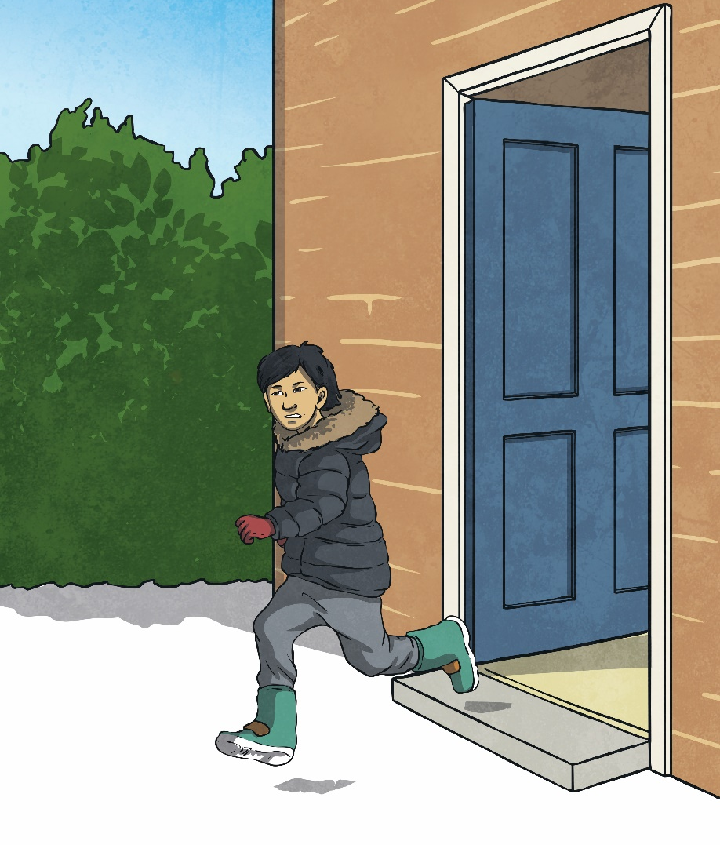
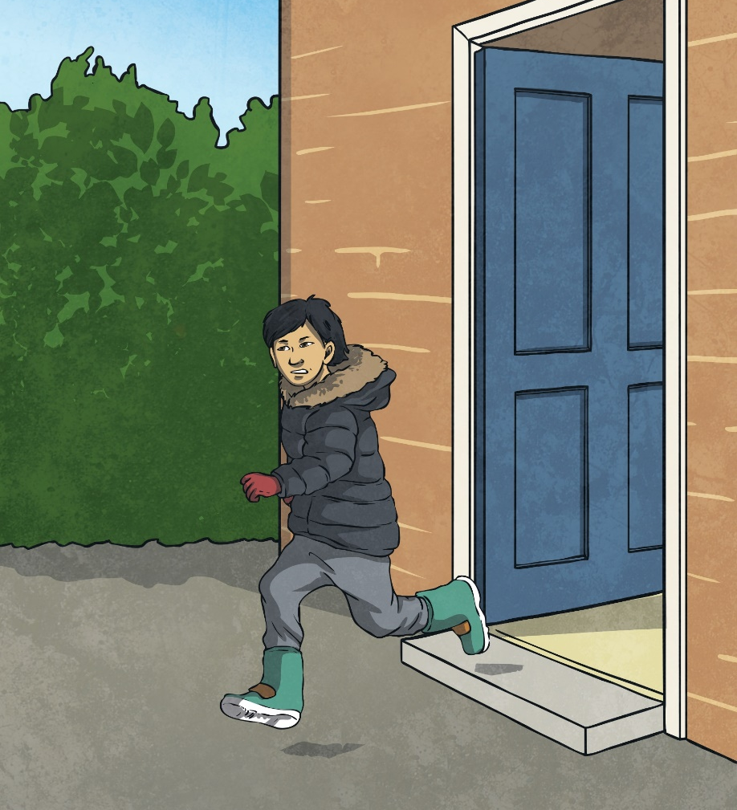
An Icy Day
Yet again, Pradeep was running late for school. He had been busy watching cartoons and hadn’t heard his mum telling him it was time to get ready. By the time Pradeep had gulped down his breakfast, washed his face, brushed his teeth and got into his school uniform, there were only five minutes until the bell would ring. Grabbing his coat and gloves – it was the first icy day of winter – Pradeep ran out of the front door.

Slide 3
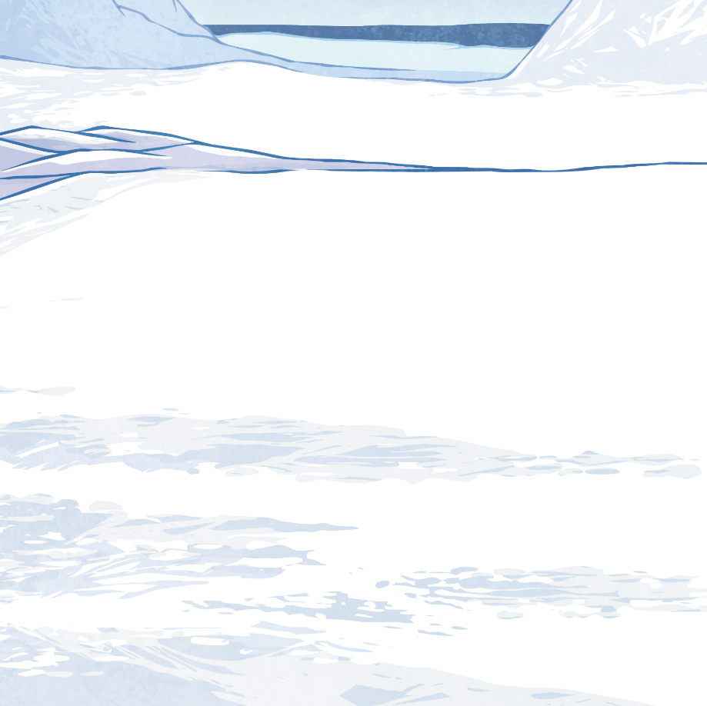
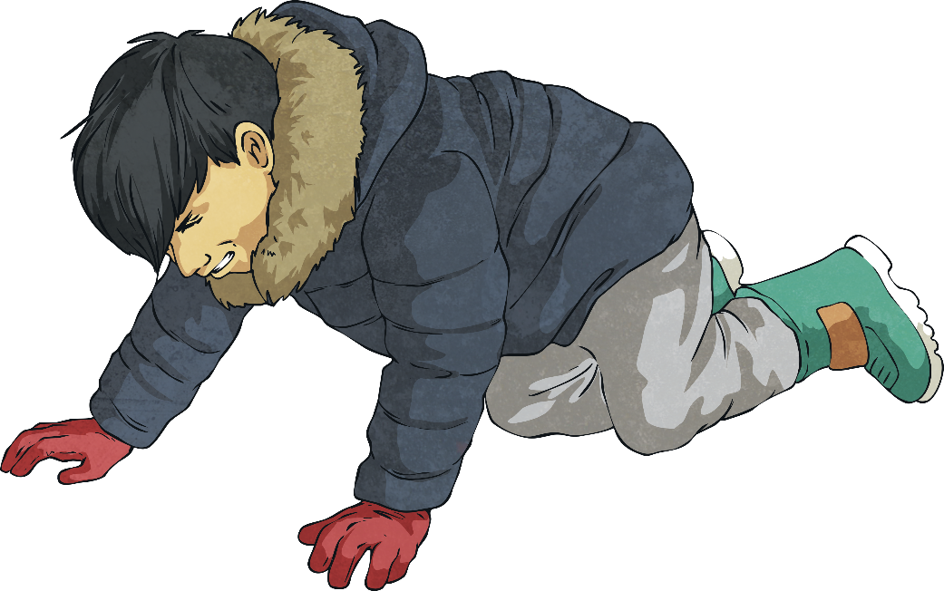
An Icy Day
Seconds after Pradeep had gone out the door, he felt himself slip. Bump! He landed on the floor with a thud. Pradeep looked at the icy ground around him.
Talk About It
Why do you think Pradeep fell over?

Slide 4
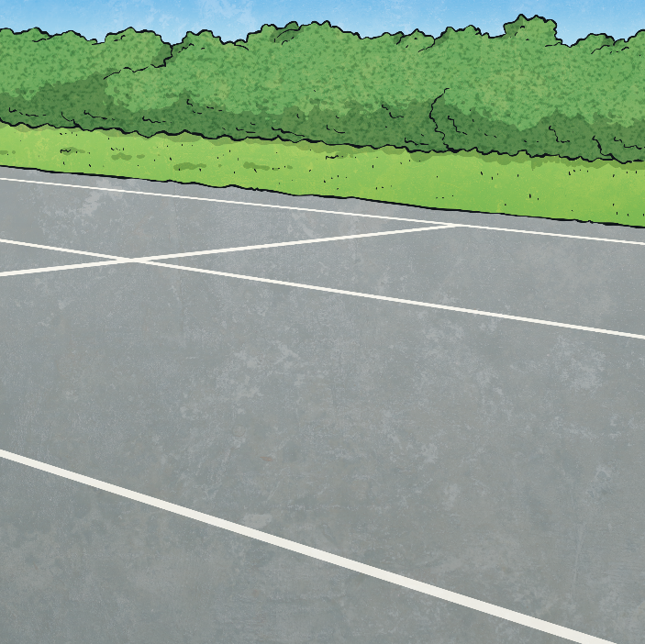
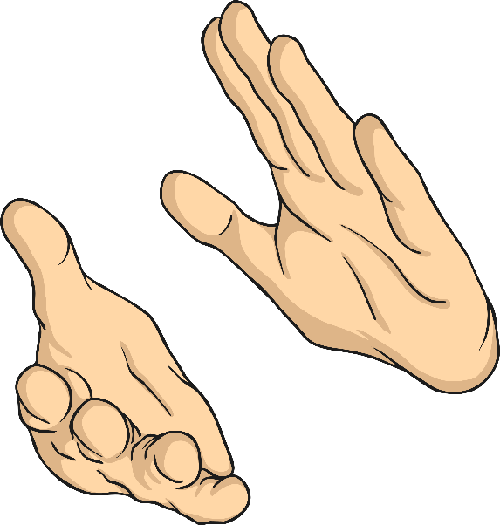
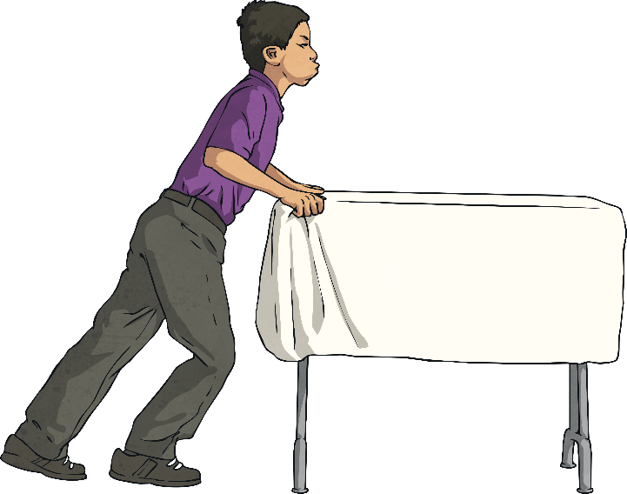
What Is Friction?
Friction is a force between two different surfaces that slide against each other.
Have you ever helped move a table in your classroom? Friction is the force acting against you which means you have to push hard when moving the table.
The smoother the surface, the less friction there is.
So it would be easier to move the table across an
ice rink than it would be to move it across the
bumpy playground surface.
Rub your hands together. What can you feel?
Did your hands feel hot?
Rubbing your hands together makes friction.
Friction makes heat.

Slide 5
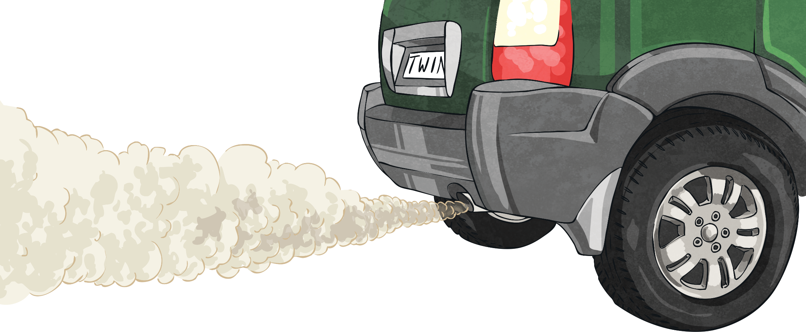
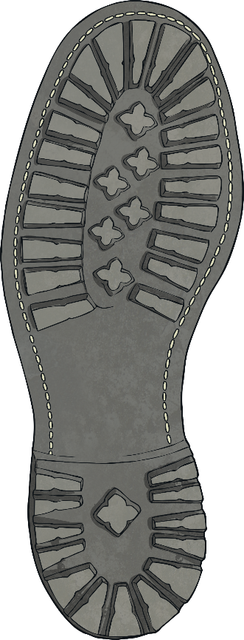
When Is Friction Useful?
Have you noticed that car tyres have ridges in them? This means the tyres aren’t smooth.
Friction is useful because it helps to stop cars from skidding all over the road.
Look at the bottom of your shoe.
What can you see?
If your shoes have a bumpy pattern on the sole, you are using friction! The pattern creates friction which helps stop you from slipping over.

Slide 6
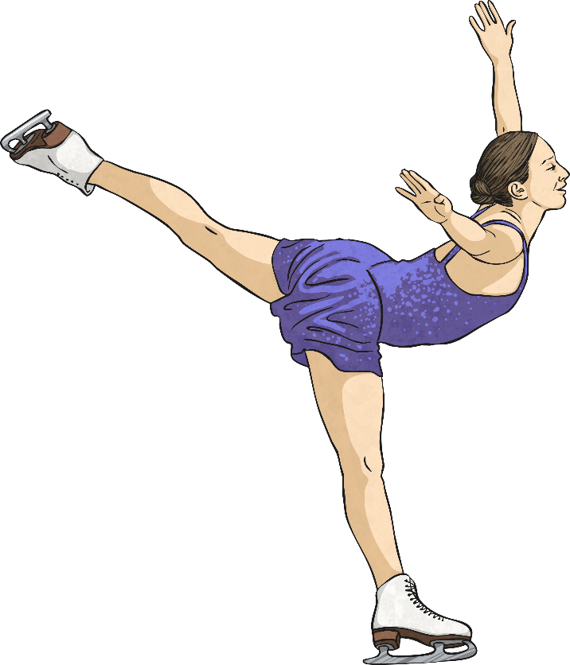
Different Surfaces
The smoother a surface, the less friction there will be. This is why an ice skater can glide so smoothly across ice.
Would an ice skater be able to glide across concrete? How about sandpaper?
Talk About It

Slide 7
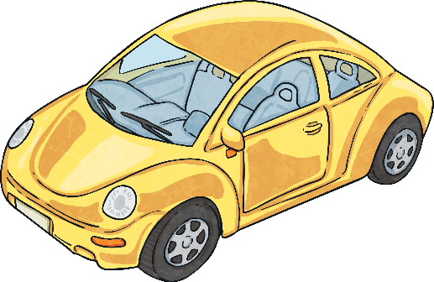
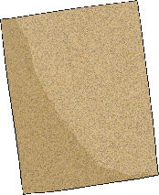
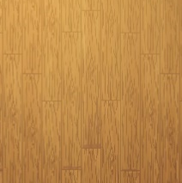
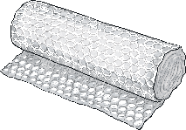
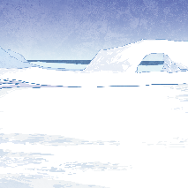
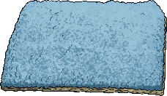
Toy Car
Have you ever played with a toy car which you pull back and then let go? Using one of these cars is a good way to explore friction on different surfaces.
Which of these surfaces would cause a lot of friction for a toy car and which would cause little friction?
sandpaper
bubble wrap
shiny wooden floor
Lots of friction
sandpaper
bubble wrap
carpet
Little friction
shiny wooden floor
ice
ice
carpet

Slide 8

Pradeep
Pradeep fell over because the ground outside his front door was icy. His shoes didn’t have much of a bumpy pattern on them. This meant that not much friction was produced and he fell over.
Pradeep decided that next time it was
icy, he would wear his wellington boots which have lots of grip on the bottom.
He knew this would make lots of friction
and help stop him from falling over.

Slide 9
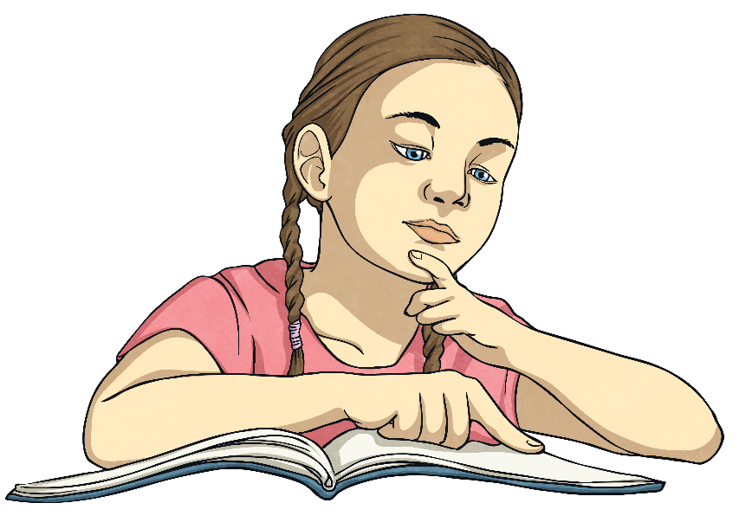
What Have We Learnt?
Friction is a force.
The smoother the surface the less friction there will be.
Friction produces heat.
_____.
________.
____.

Slide 10
