Slide 1


Maths
Measurement
Year One
Maths | Year 3 | Measurement | Measure, Compare, Add and Subtract Units of Measurement | Lesson 8 of 8: Comparing Lengths

Slide 2


Comparing Lengths

Slide 3
Aim
I can compare measurements in m, cm and mm.
Success Criteria
I can compare single-unit length measurements.
I can compare mixed-unit length measurements.

Slide 4

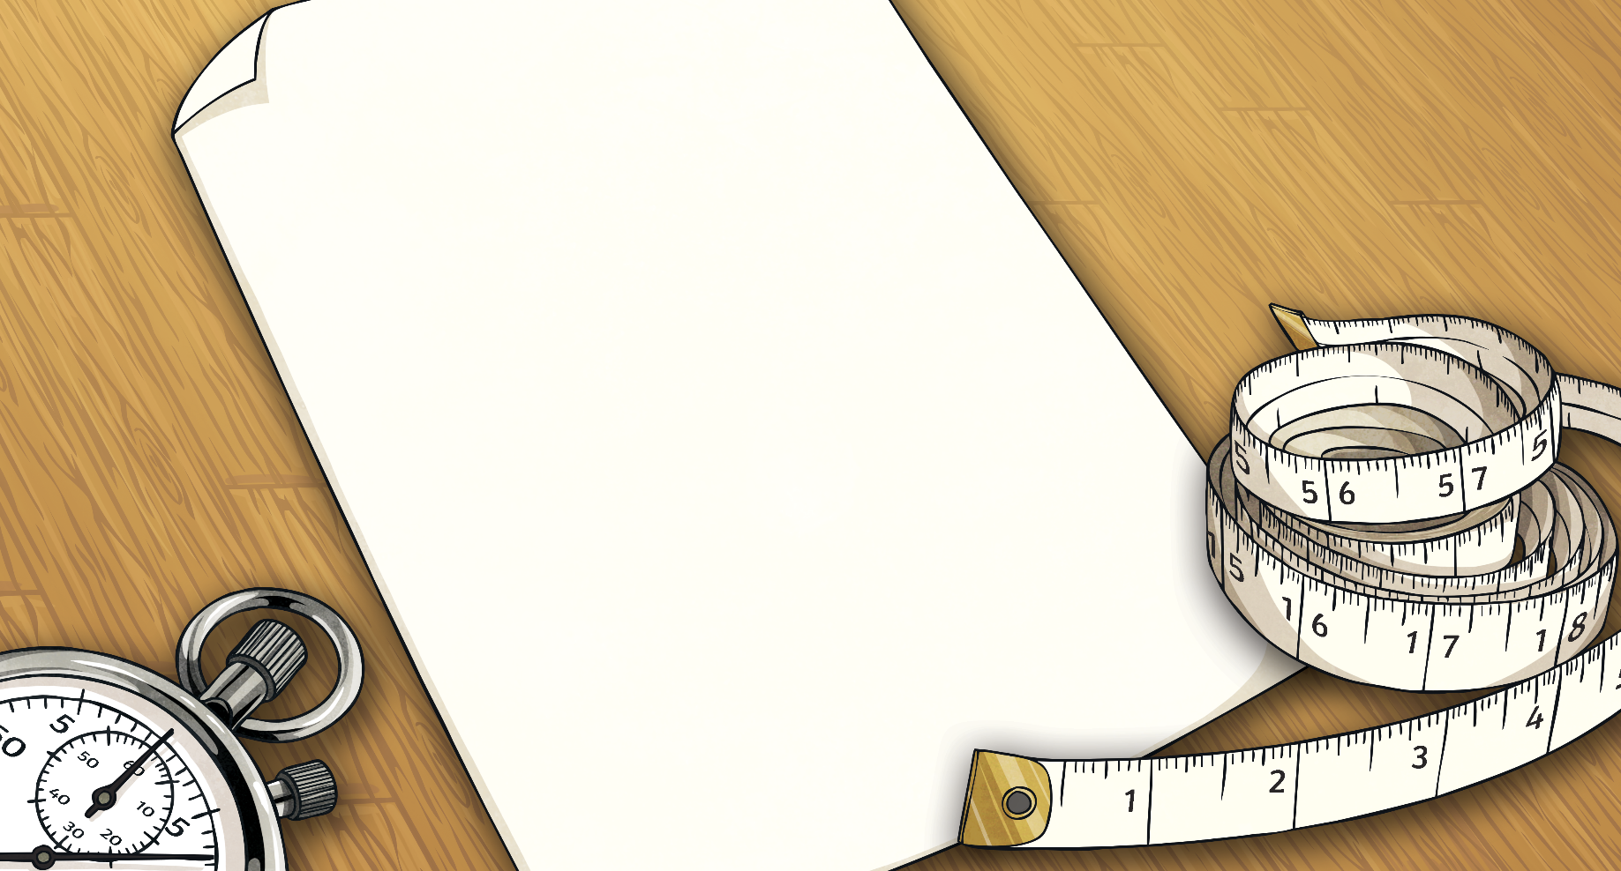
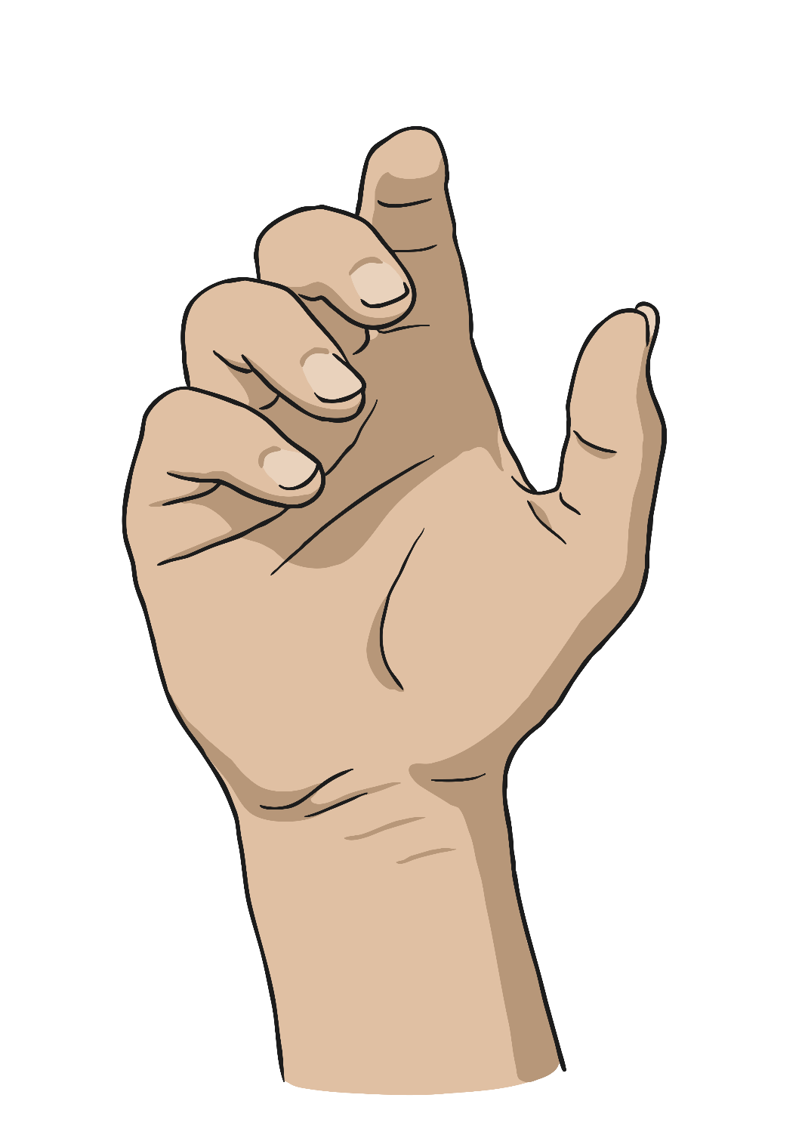
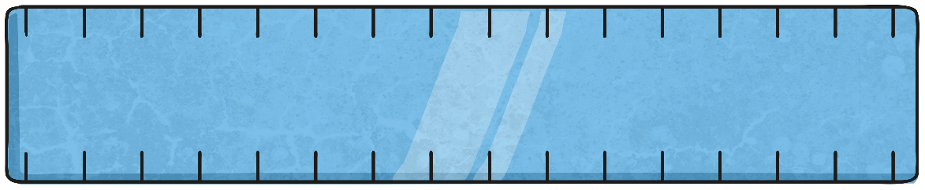
Convert It
There are 10 millimetres in 1 centimetre.
Convert these centimetre measurements to millimetres:
5cm = 50mm
5cm = ?mm

Slide 5
Convert It
There are 10 millimetres in 1 centimetre.
Convert these centimetre measurements to millimetres:
7cm = 70mm
7cm = ?mm

Slide 6
Convert It
There are 10 millimetres in 1 centimetre.
Convert these centimetre measurements to millimetres:
4cm = 40mm
4cm = ?mm

Slide 7
Convert It
There are 10 millimetres in 1 centimetre.
Convert these centimetre measurements to millimetres:
9cm = 90mm
9cm = ?mm

Slide 8
Convert It
There are 10 millimetres in 1 centimetre.
Convert these centimetre measurements to millimetres:
2cm 4mm = 24mm
2cm 4mm = ?mm

Slide 9
Convert It
There are 10 millimetres in 1 centimetre.
Convert these centimetre measurements to millimetres:
6cm 5mm = 65mm
6cm 5mm = ?mm

Slide 10
Convert It
There are 100 centimetres in 1 metre.
Convert these metre measurements to centimetres:
9m = 900cm
9m = ?cm

Slide 11
Convert It
There are 100 centimetres in 1 metre.
Convert these metre measurements to centimetres:
7m = 700cm
7m = ?cm

Slide 12
Convert It
There are 100 centimetres in 1 metre.
Convert these metre measurements to centimetres:
2m = 200cm
2m = ?cm

Slide 13
Convert It
There are 100 centimetres in 1 metre.
Convert these metre measurements to centimetres:
8m = 800cm
8m = ?cm

Slide 14
Convert It
There are 100 centimetres in 1 metre.
Convert these metre measurements to centimetres:
1m 30cm = 130cm
1m 30cm = ?cm

Slide 15
Convert It
There are 100 centimetres in 1 metre.
Convert these metre measurements to centimetres:
2m 45cm = 245cm
2m 45cm = ?cm

Slide 16

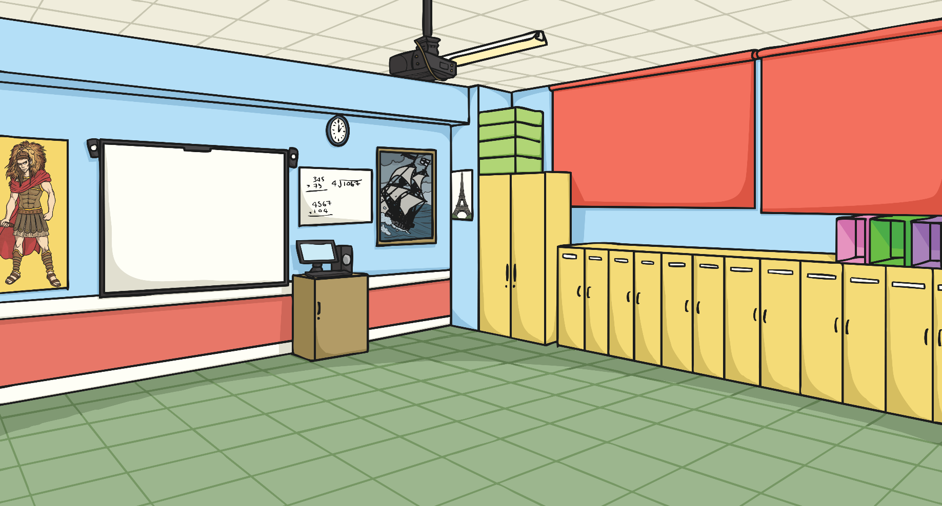

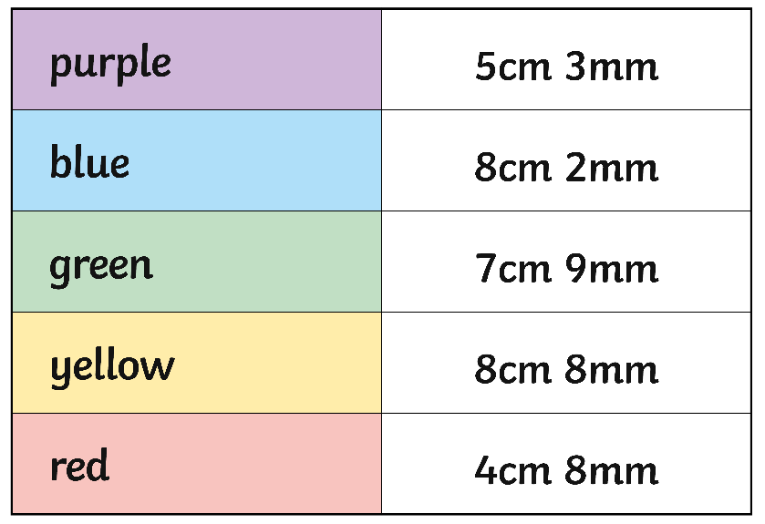

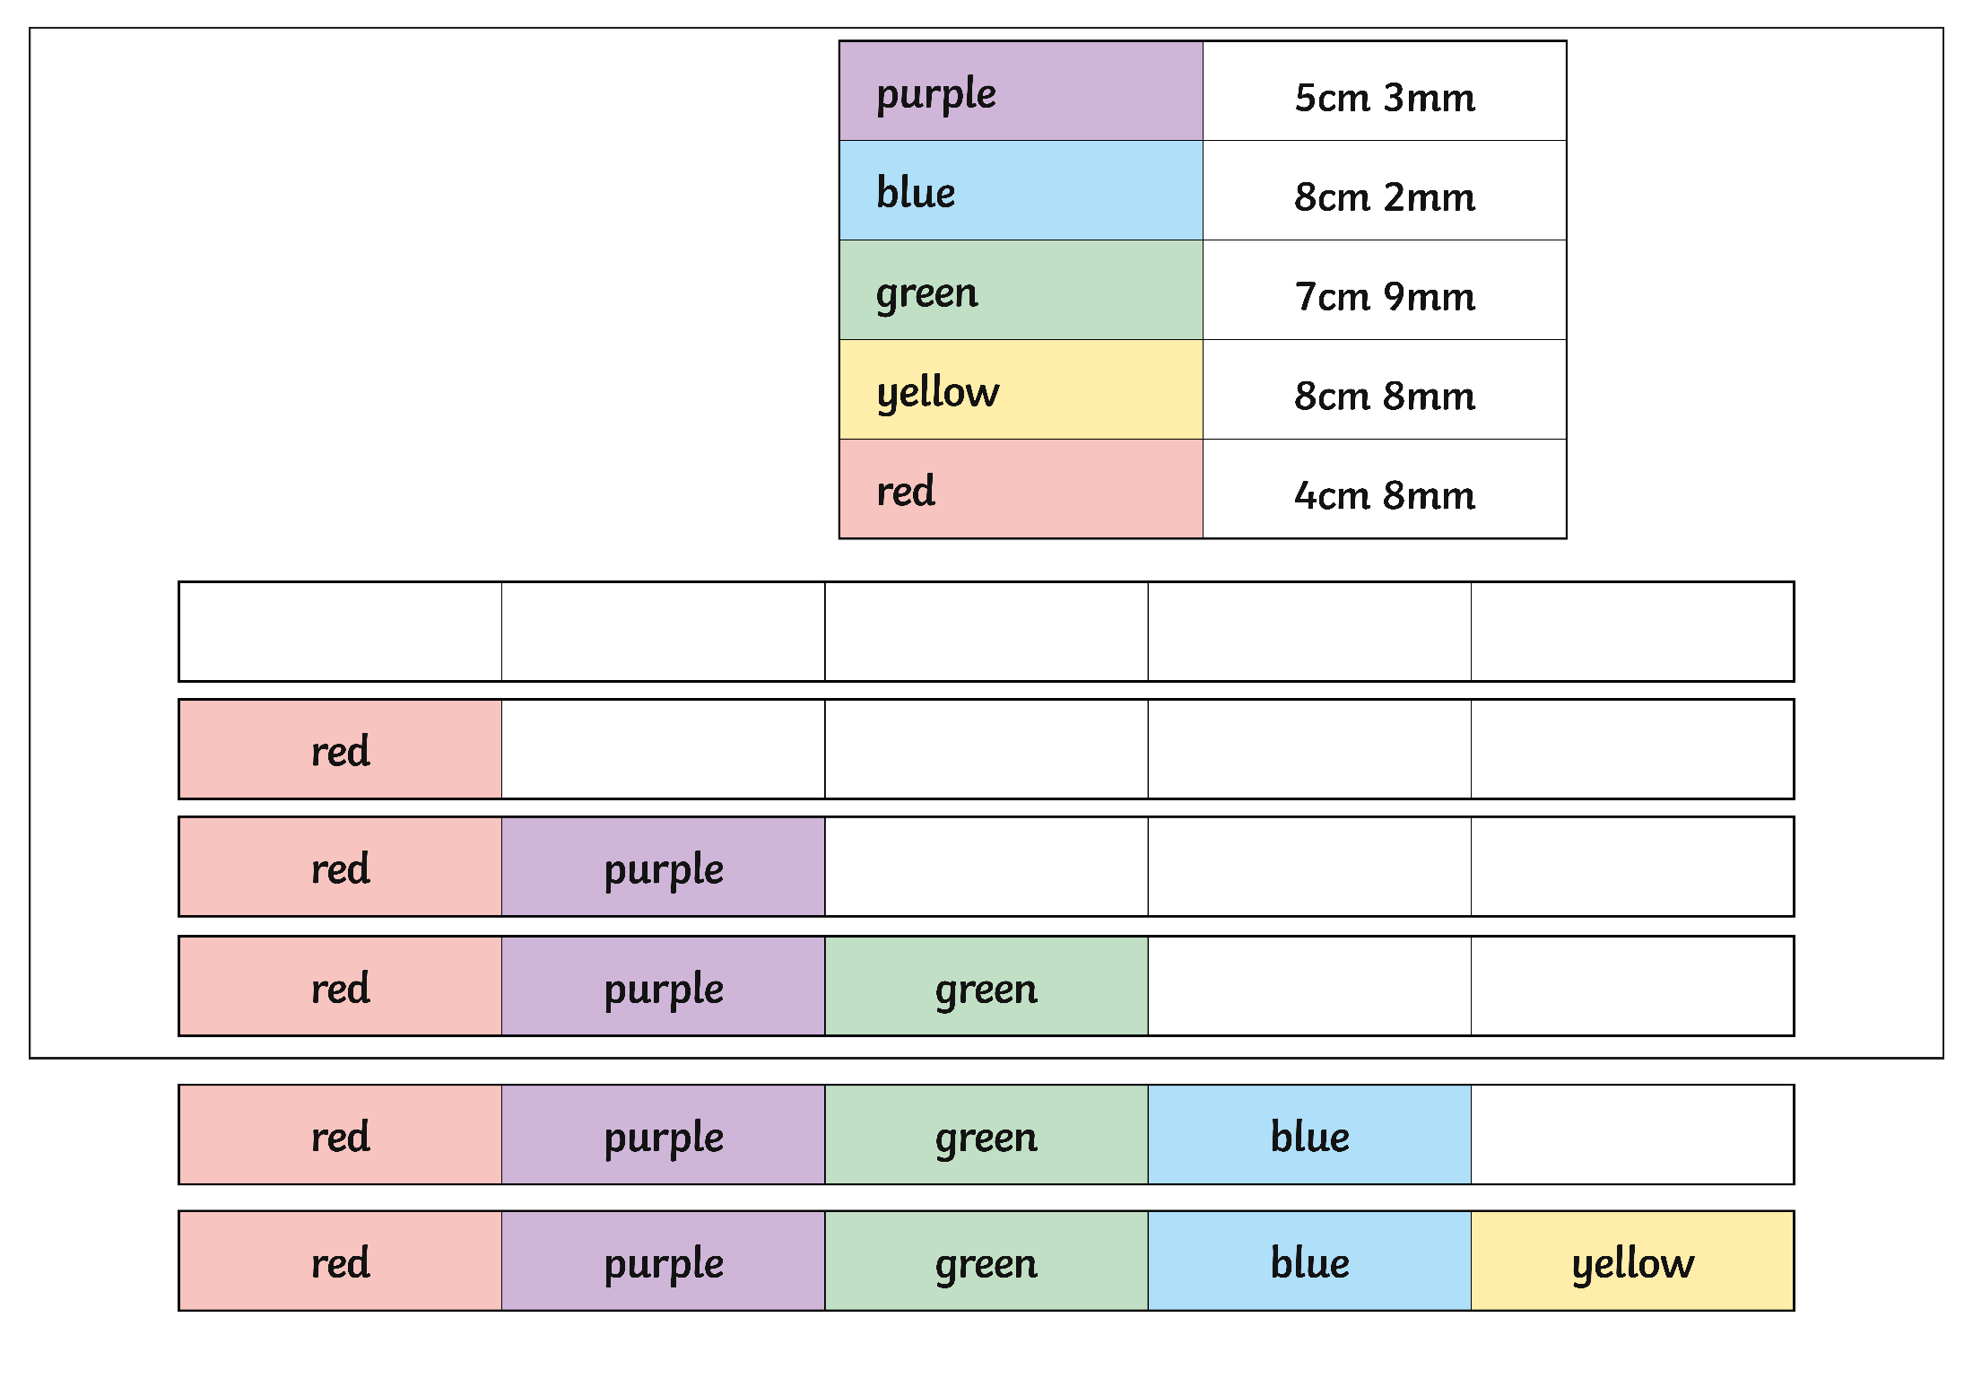
Pencils
Here are some pencil crayons.
After they have been used they measure:
Order the pencil crayons from shortest to longest.

Slide 17

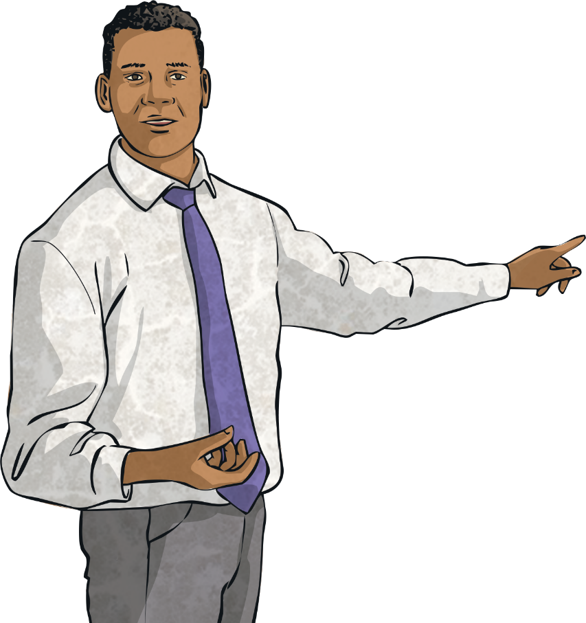
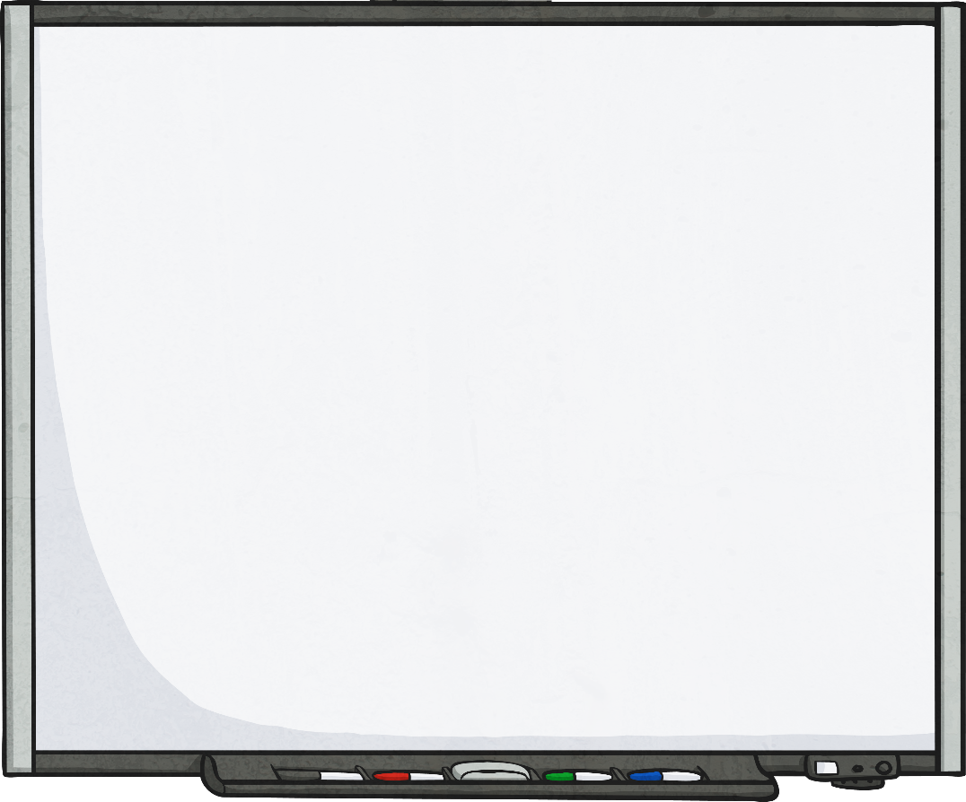
Comparing Measurement
Do you know what these symbols mean?
<
means ‘less than’.
We can use these symbols to compare all kinds of measurements.
>
means ‘greater than’.
=
means ‘equal to’.

Slide 18

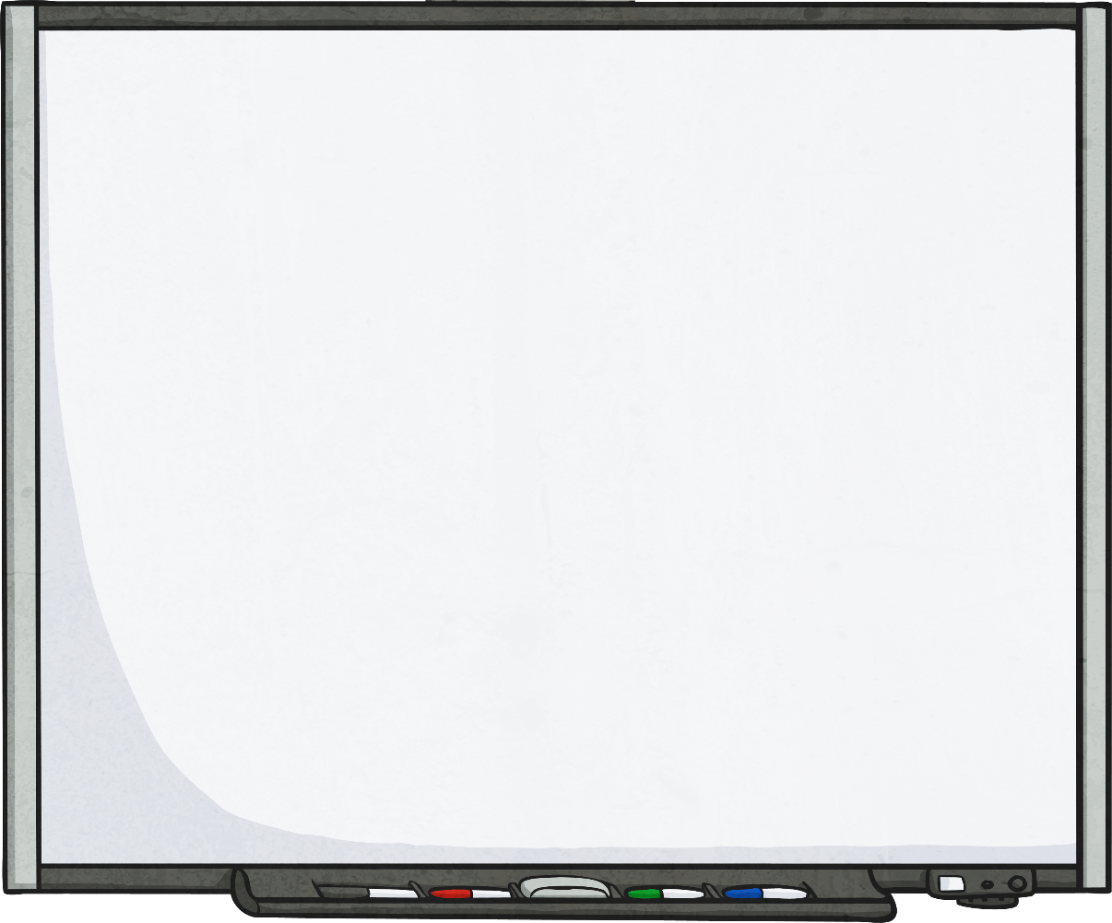

Comparing Measurement
Compare these measurements using <, > or =
<
2cm
5cm

Slide 19
Comparing Measurement
Compare these measurements using <, > or =
>
9cm
4cm

Slide 20
Comparing Measurement
Compare these measurements using <, > or =
<
10cm
12cm

Slide 21
Comparing Measurement
Compare these measurements using <, > or =
As the units are not the same, we need to convert the one of the measurements to find out the answer.
3cm = 30mm
<
3cm
50mm

Slide 22
Comparing Measurement
Compare these measurements using <, > or =
<
8cm
85mm

Slide 23
Comparing Measurement
Compare these measurements using <, > or =
=
4cm
40mm

Slide 24
Comparing Measurement
Compare these measurements using <, > or =
>
9cm
85mm

Slide 25
Comparing Measurement
Compare these measurements using <, > or =
>
5m
3m

Slide 26
Comparing Measurement
Compare these measurements using <, > or =
<
2m
9m

Slide 27
Comparing Measurement
Compare these measurements using <, > or =
<
3m
8m

Slide 28
Comparing Measurement
Compare these measurements using <, > or =
As the units are not the same, we need to convert the one of the measurements to find out the answer.
3m 40cm = 300cm + 40cm = 340cm
>
3m 40cm
25cm

Slide 29
Comparing Measurement
Compare these measurements using <, > or =
=
1m 20cm
120cm

Slide 30
Comparing Measurement
Compare these measurements using <, > or =
>
2m 40cm
180cm

Slide 31
Comparing Measurement
Compare these measurements using <, > or =
<
3m 50cm
480cm

Slide 32

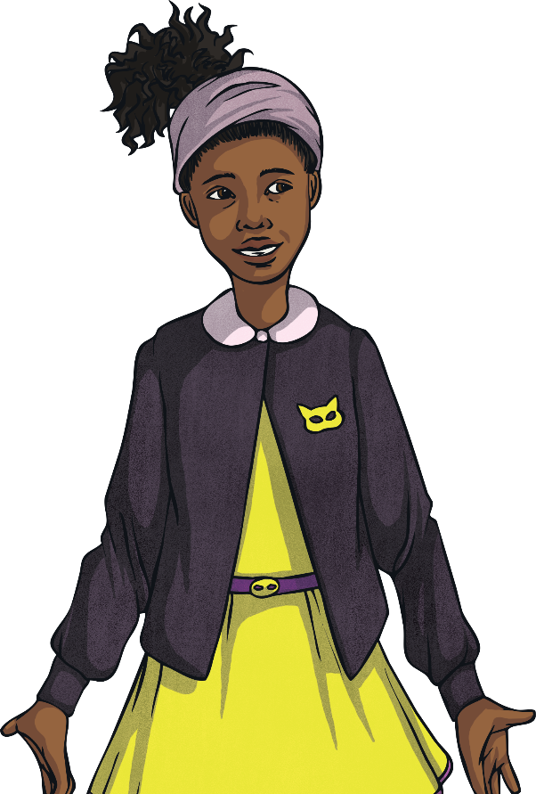
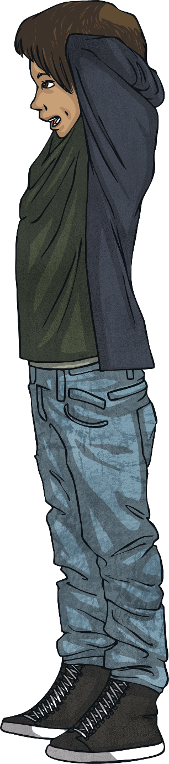
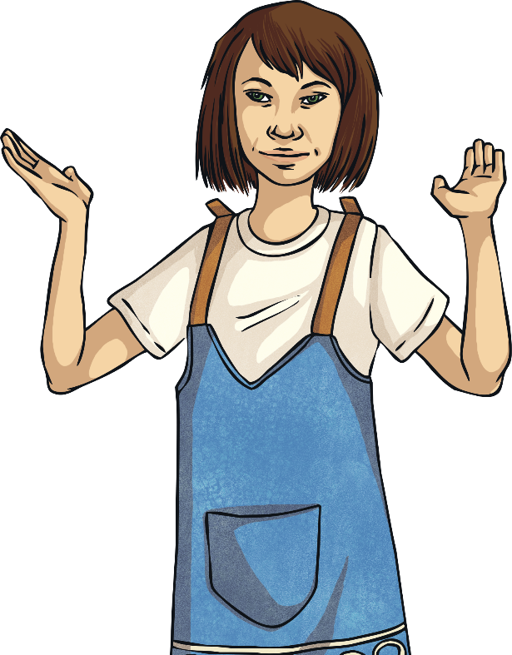
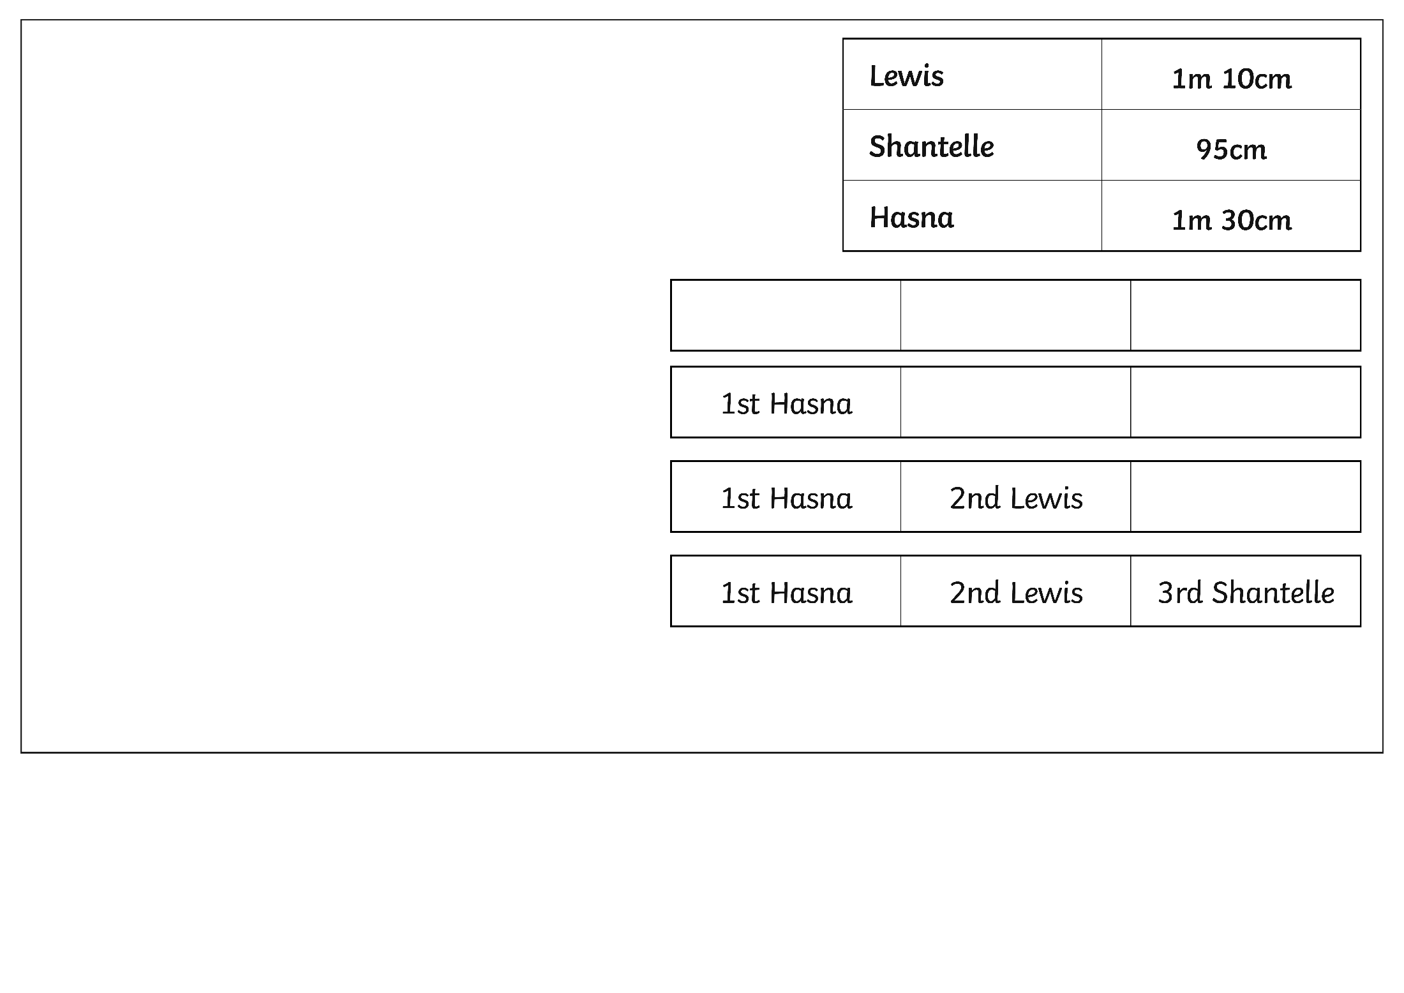
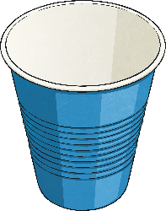
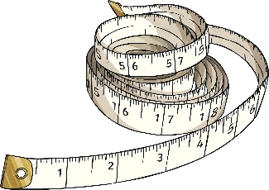

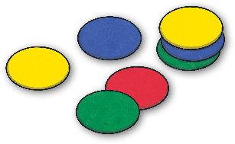
Tiddlywinks
Lewis, Shantelle and Hasna are playing tiddlywinks.
These are the distances they each flick their first tiddlywink:
Order the children from the person who flicked the longest to those
who flicked the shortest distance:

Slide 33
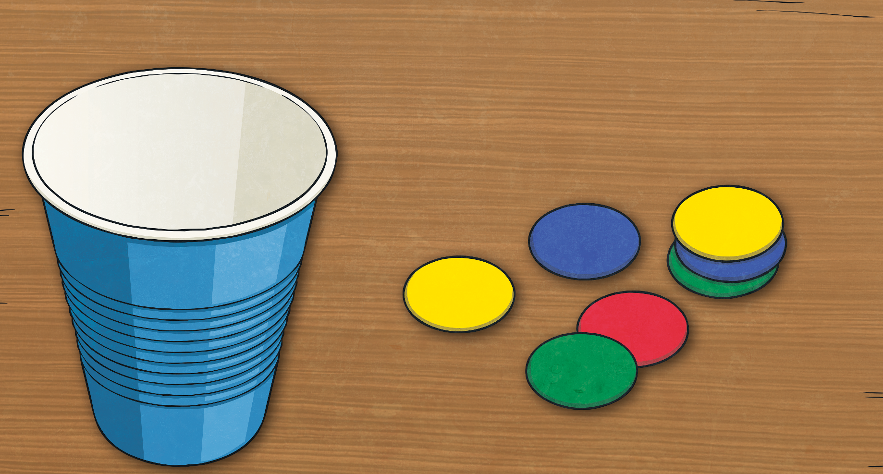
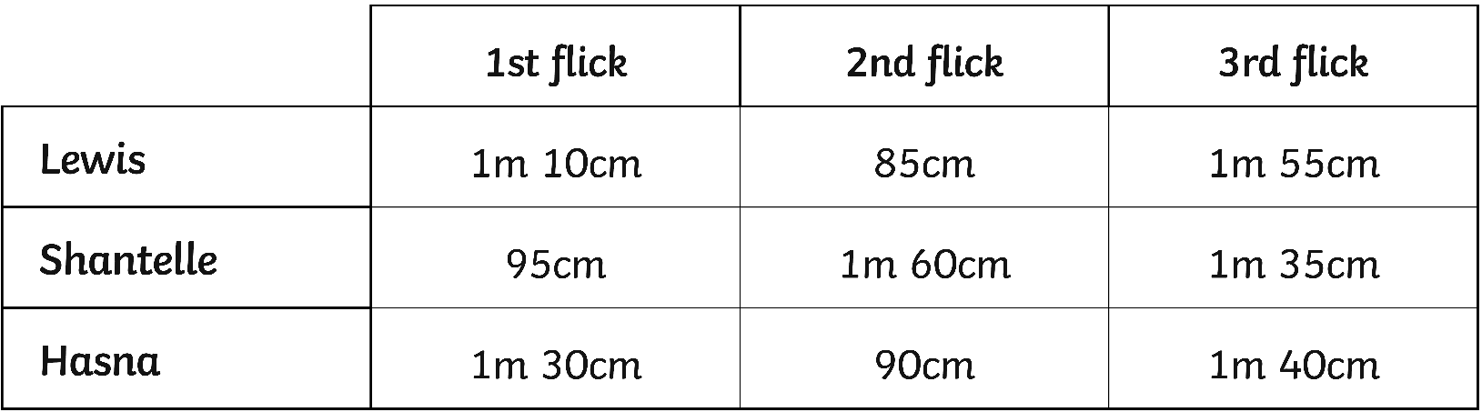
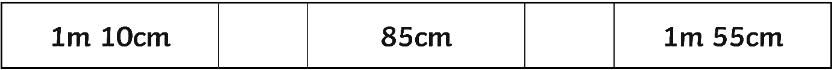
Tiddlywinks
They each flick their tiddlywinks 2 more times. Here are the results.
You can compare Lewis’ flicks like this:
>
<
110cm
155cm
Compare Shantelle and Hasna’s flicks in the same way.

Slide 34
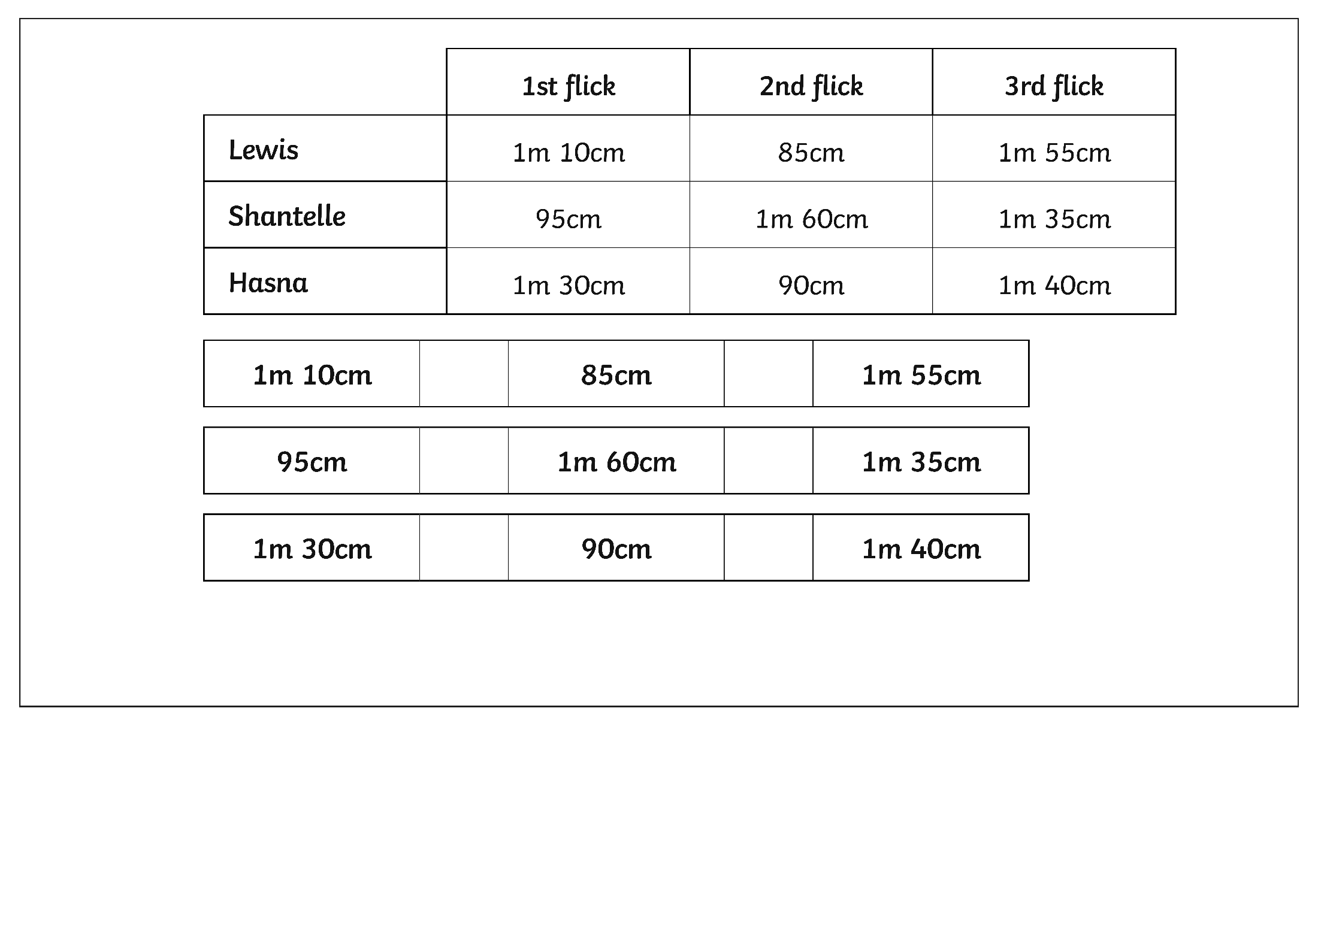
Tiddlywinks
Compare Shantelle’s flicks
<
>
160cm
135cm

Slide 35
Tiddlywinks
Compare Hasna’s flicks
>
<
130cm
140cm

Slide 36
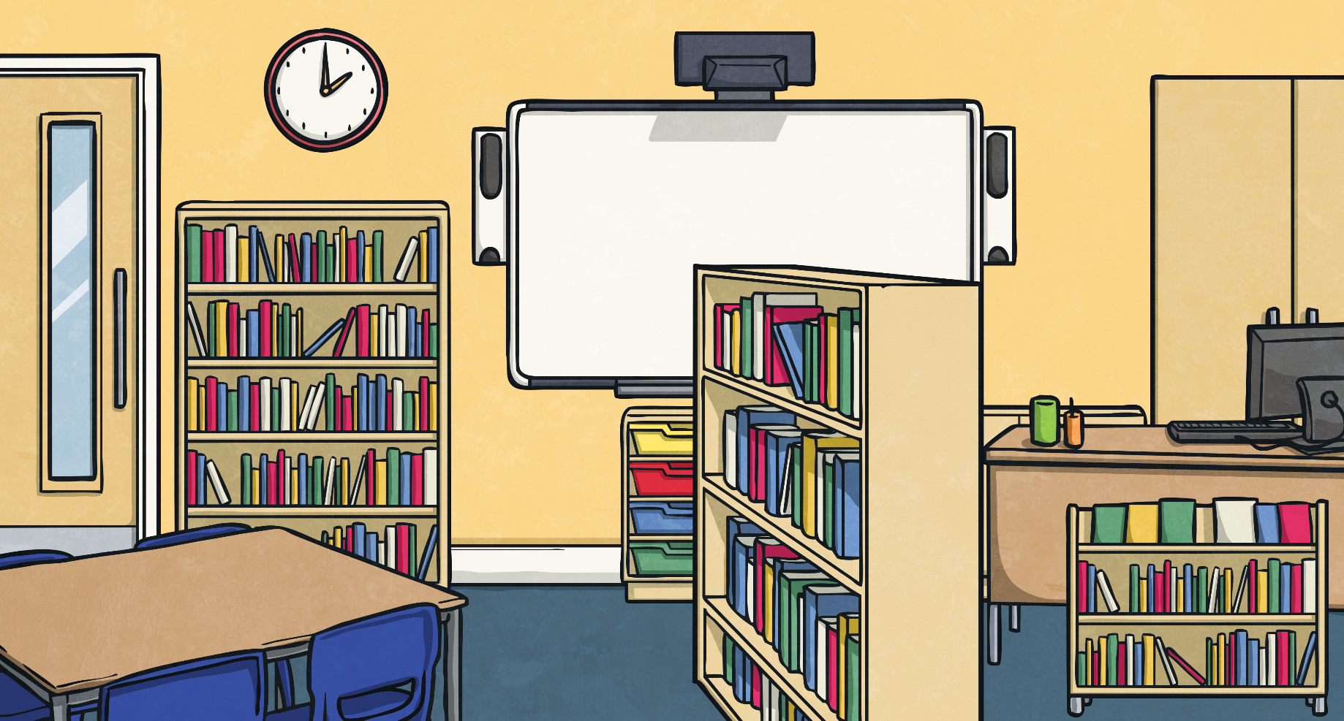
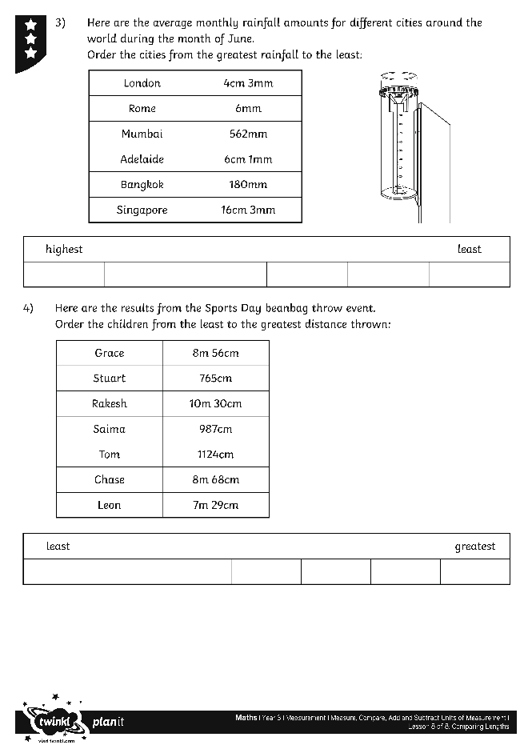
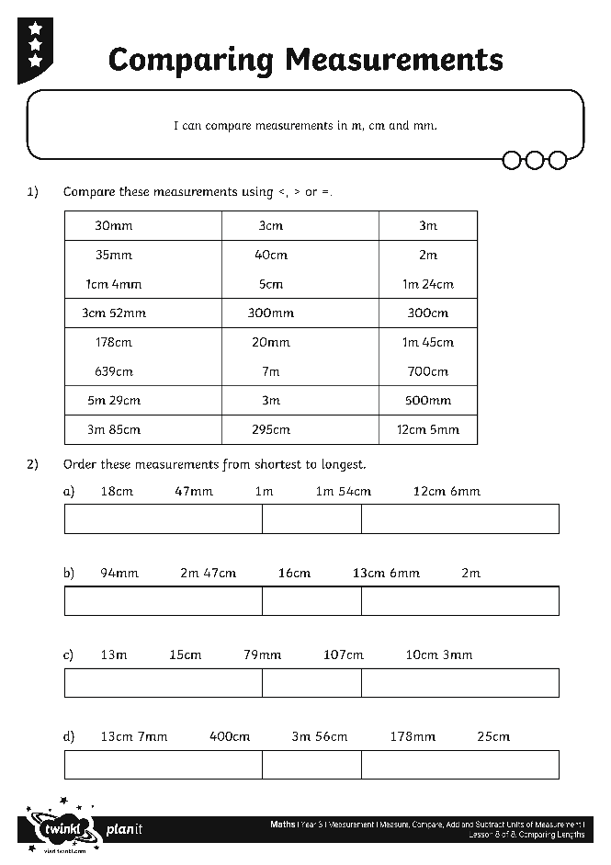
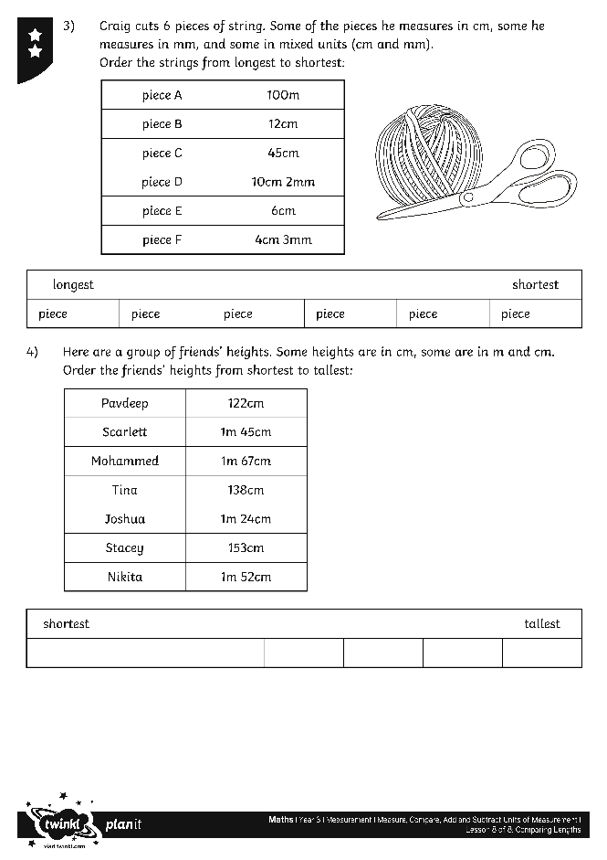
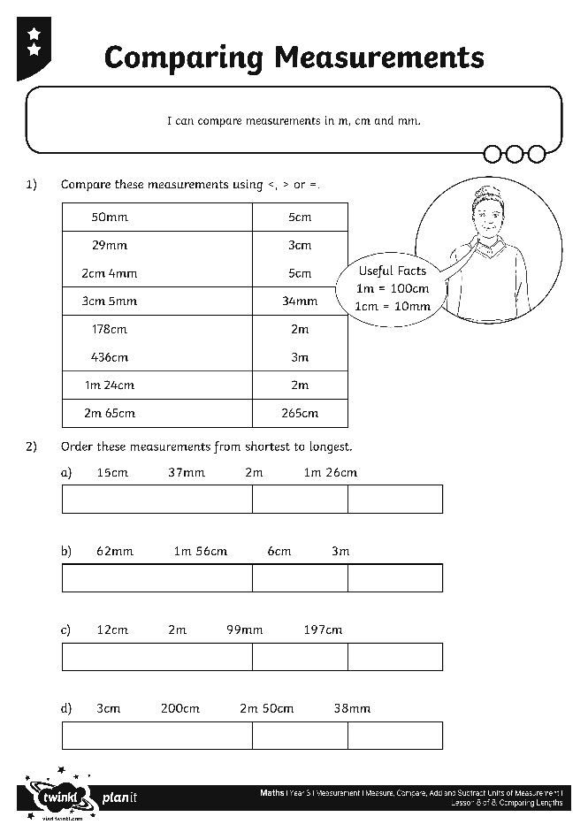
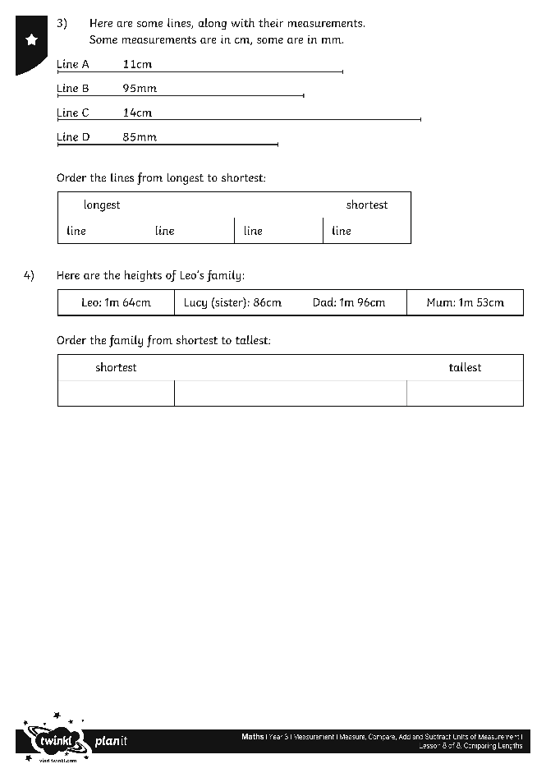
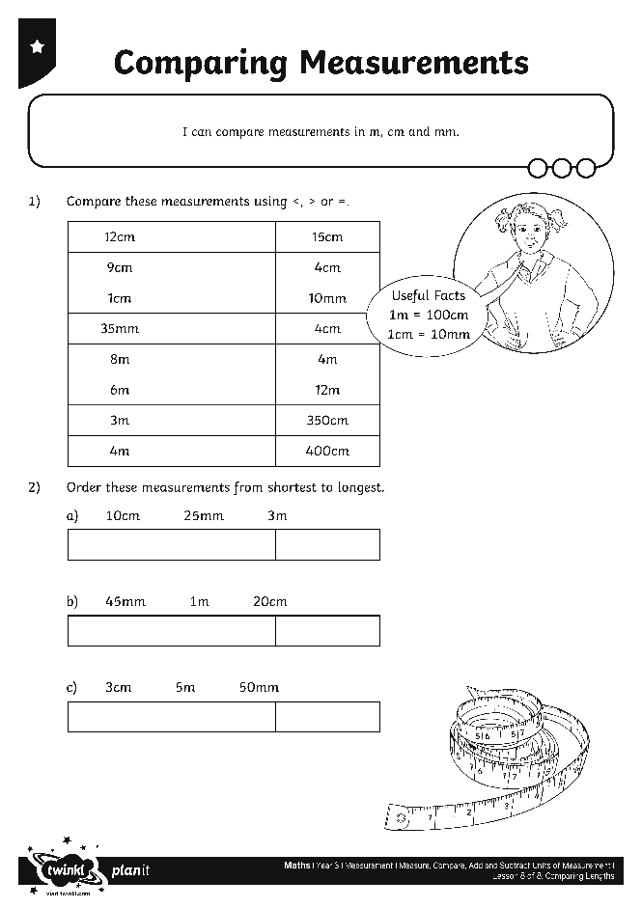
Comparing Measurements
Use your measuring mastery to complete these activity sheets.

Slide 37
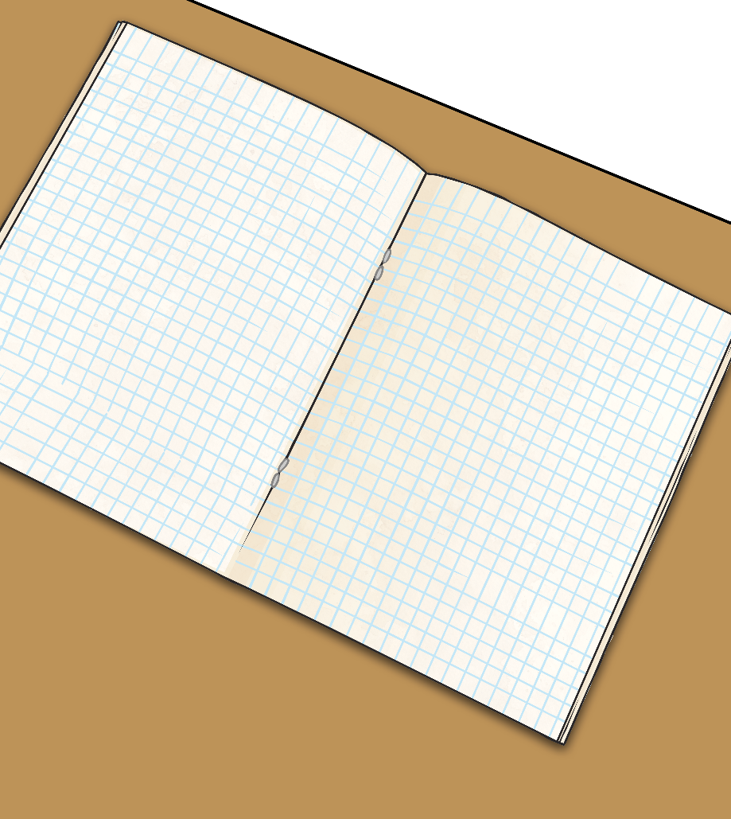
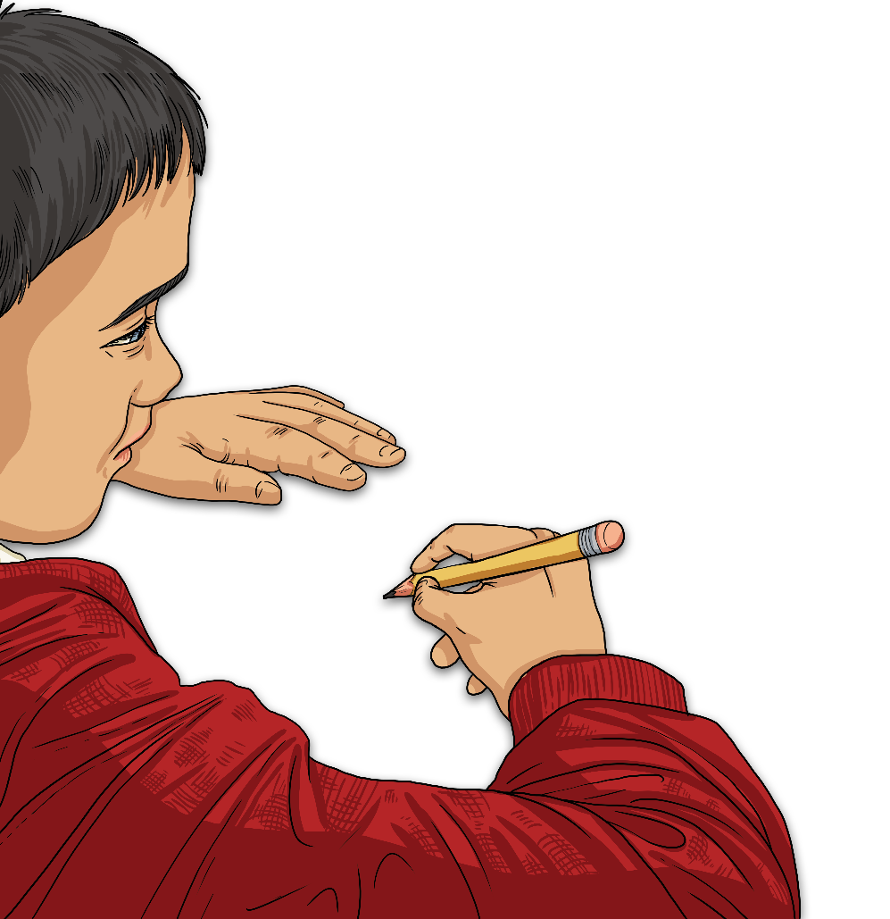
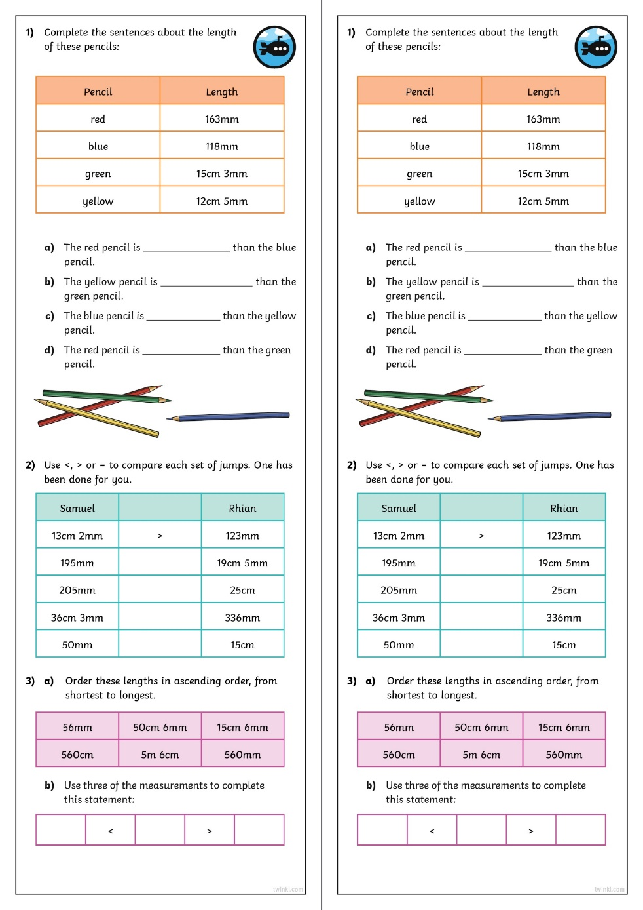
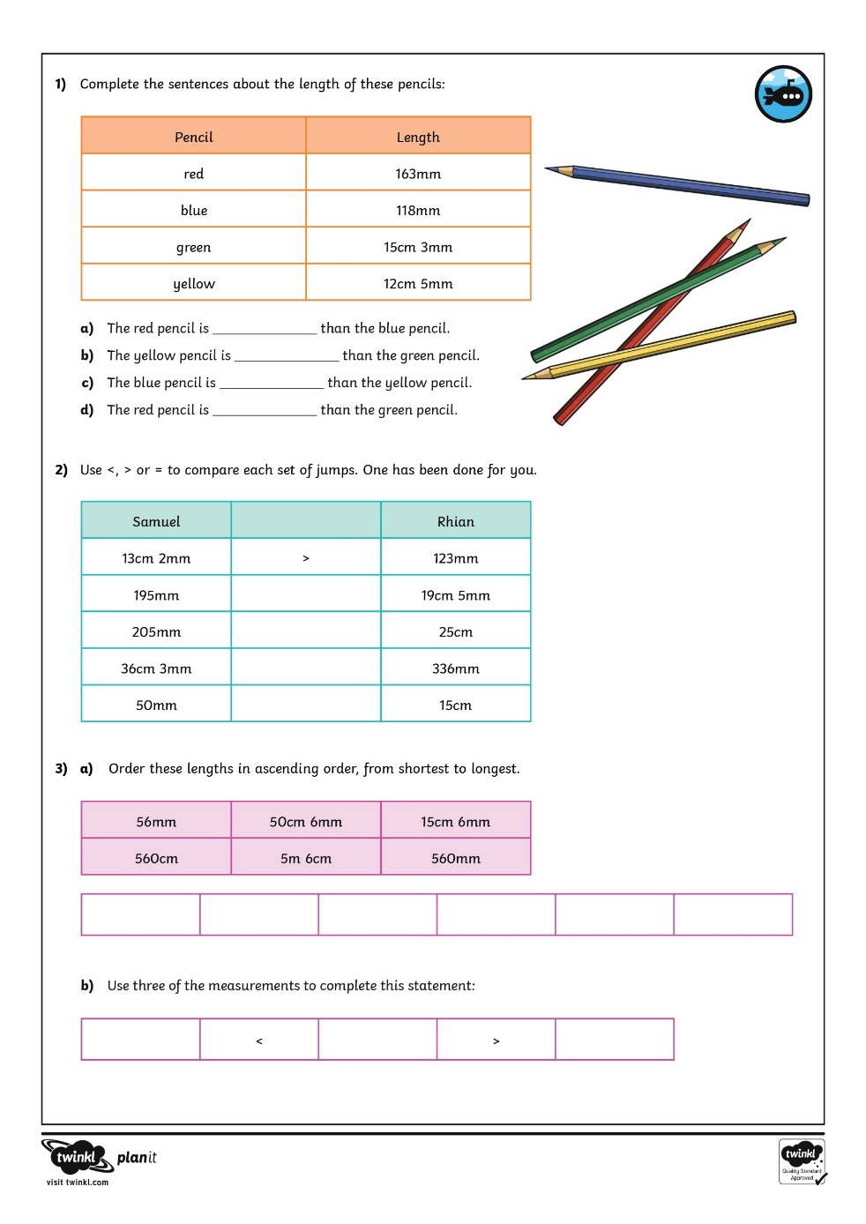

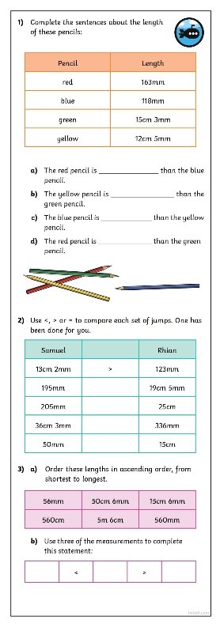
Diving into Mastery
Dive in by completing your own activity!

Slide 38
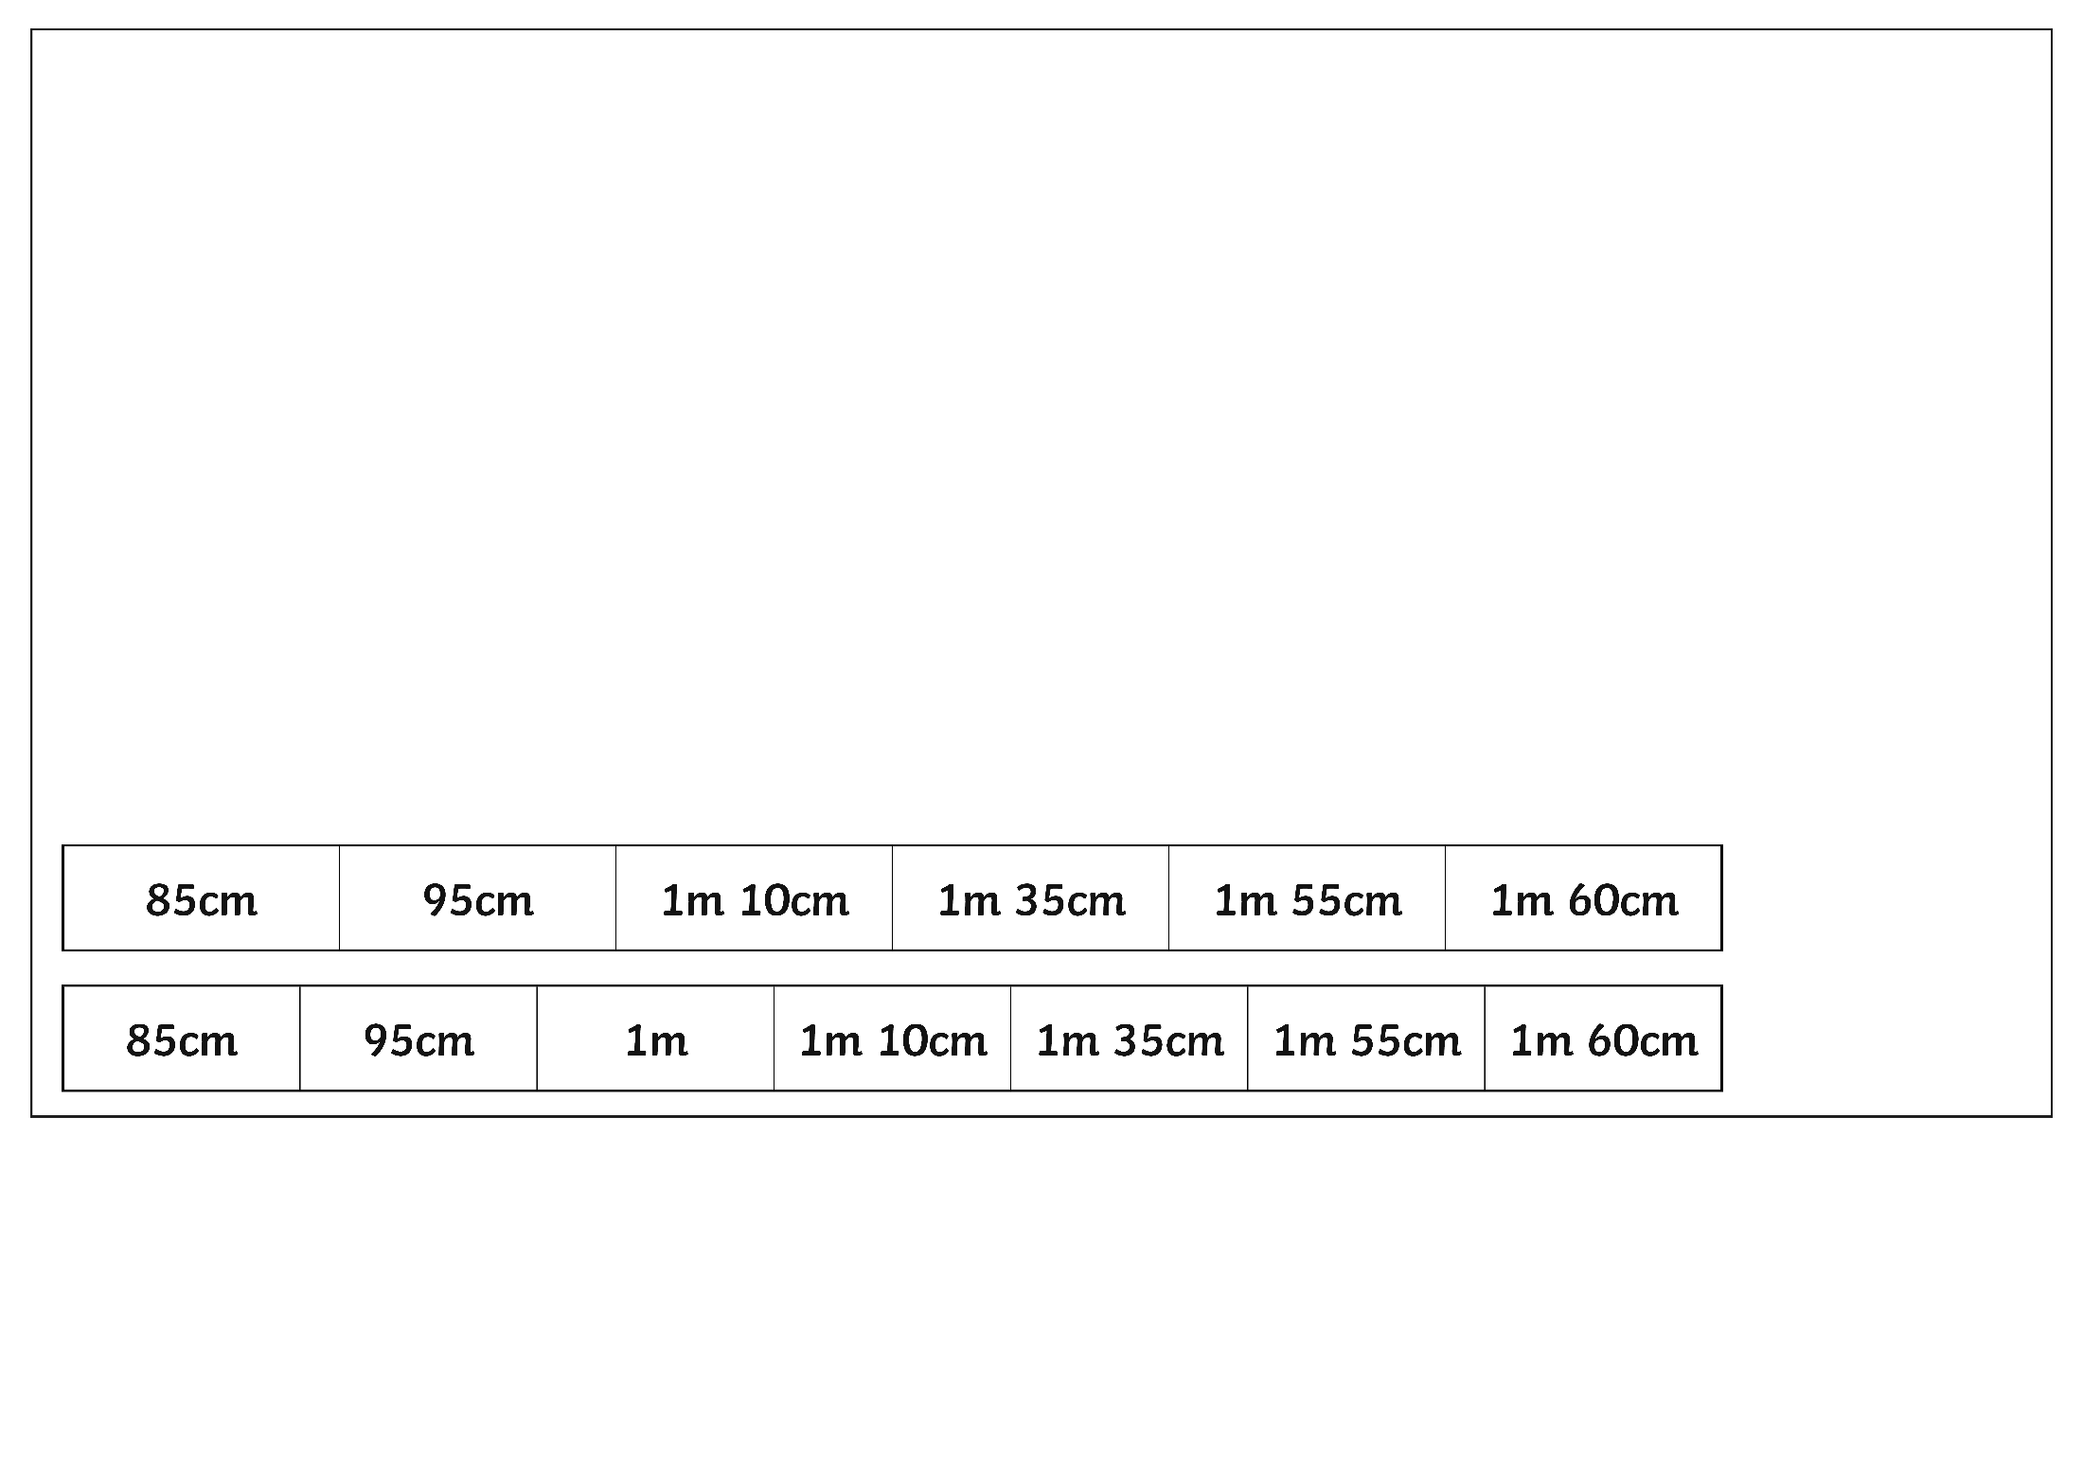
Mixed Unit Ordering
Hasna’s first flick measured 1000mm.
Where would this come in the order below?
1000mm = 100cm = 1m

Slide 39
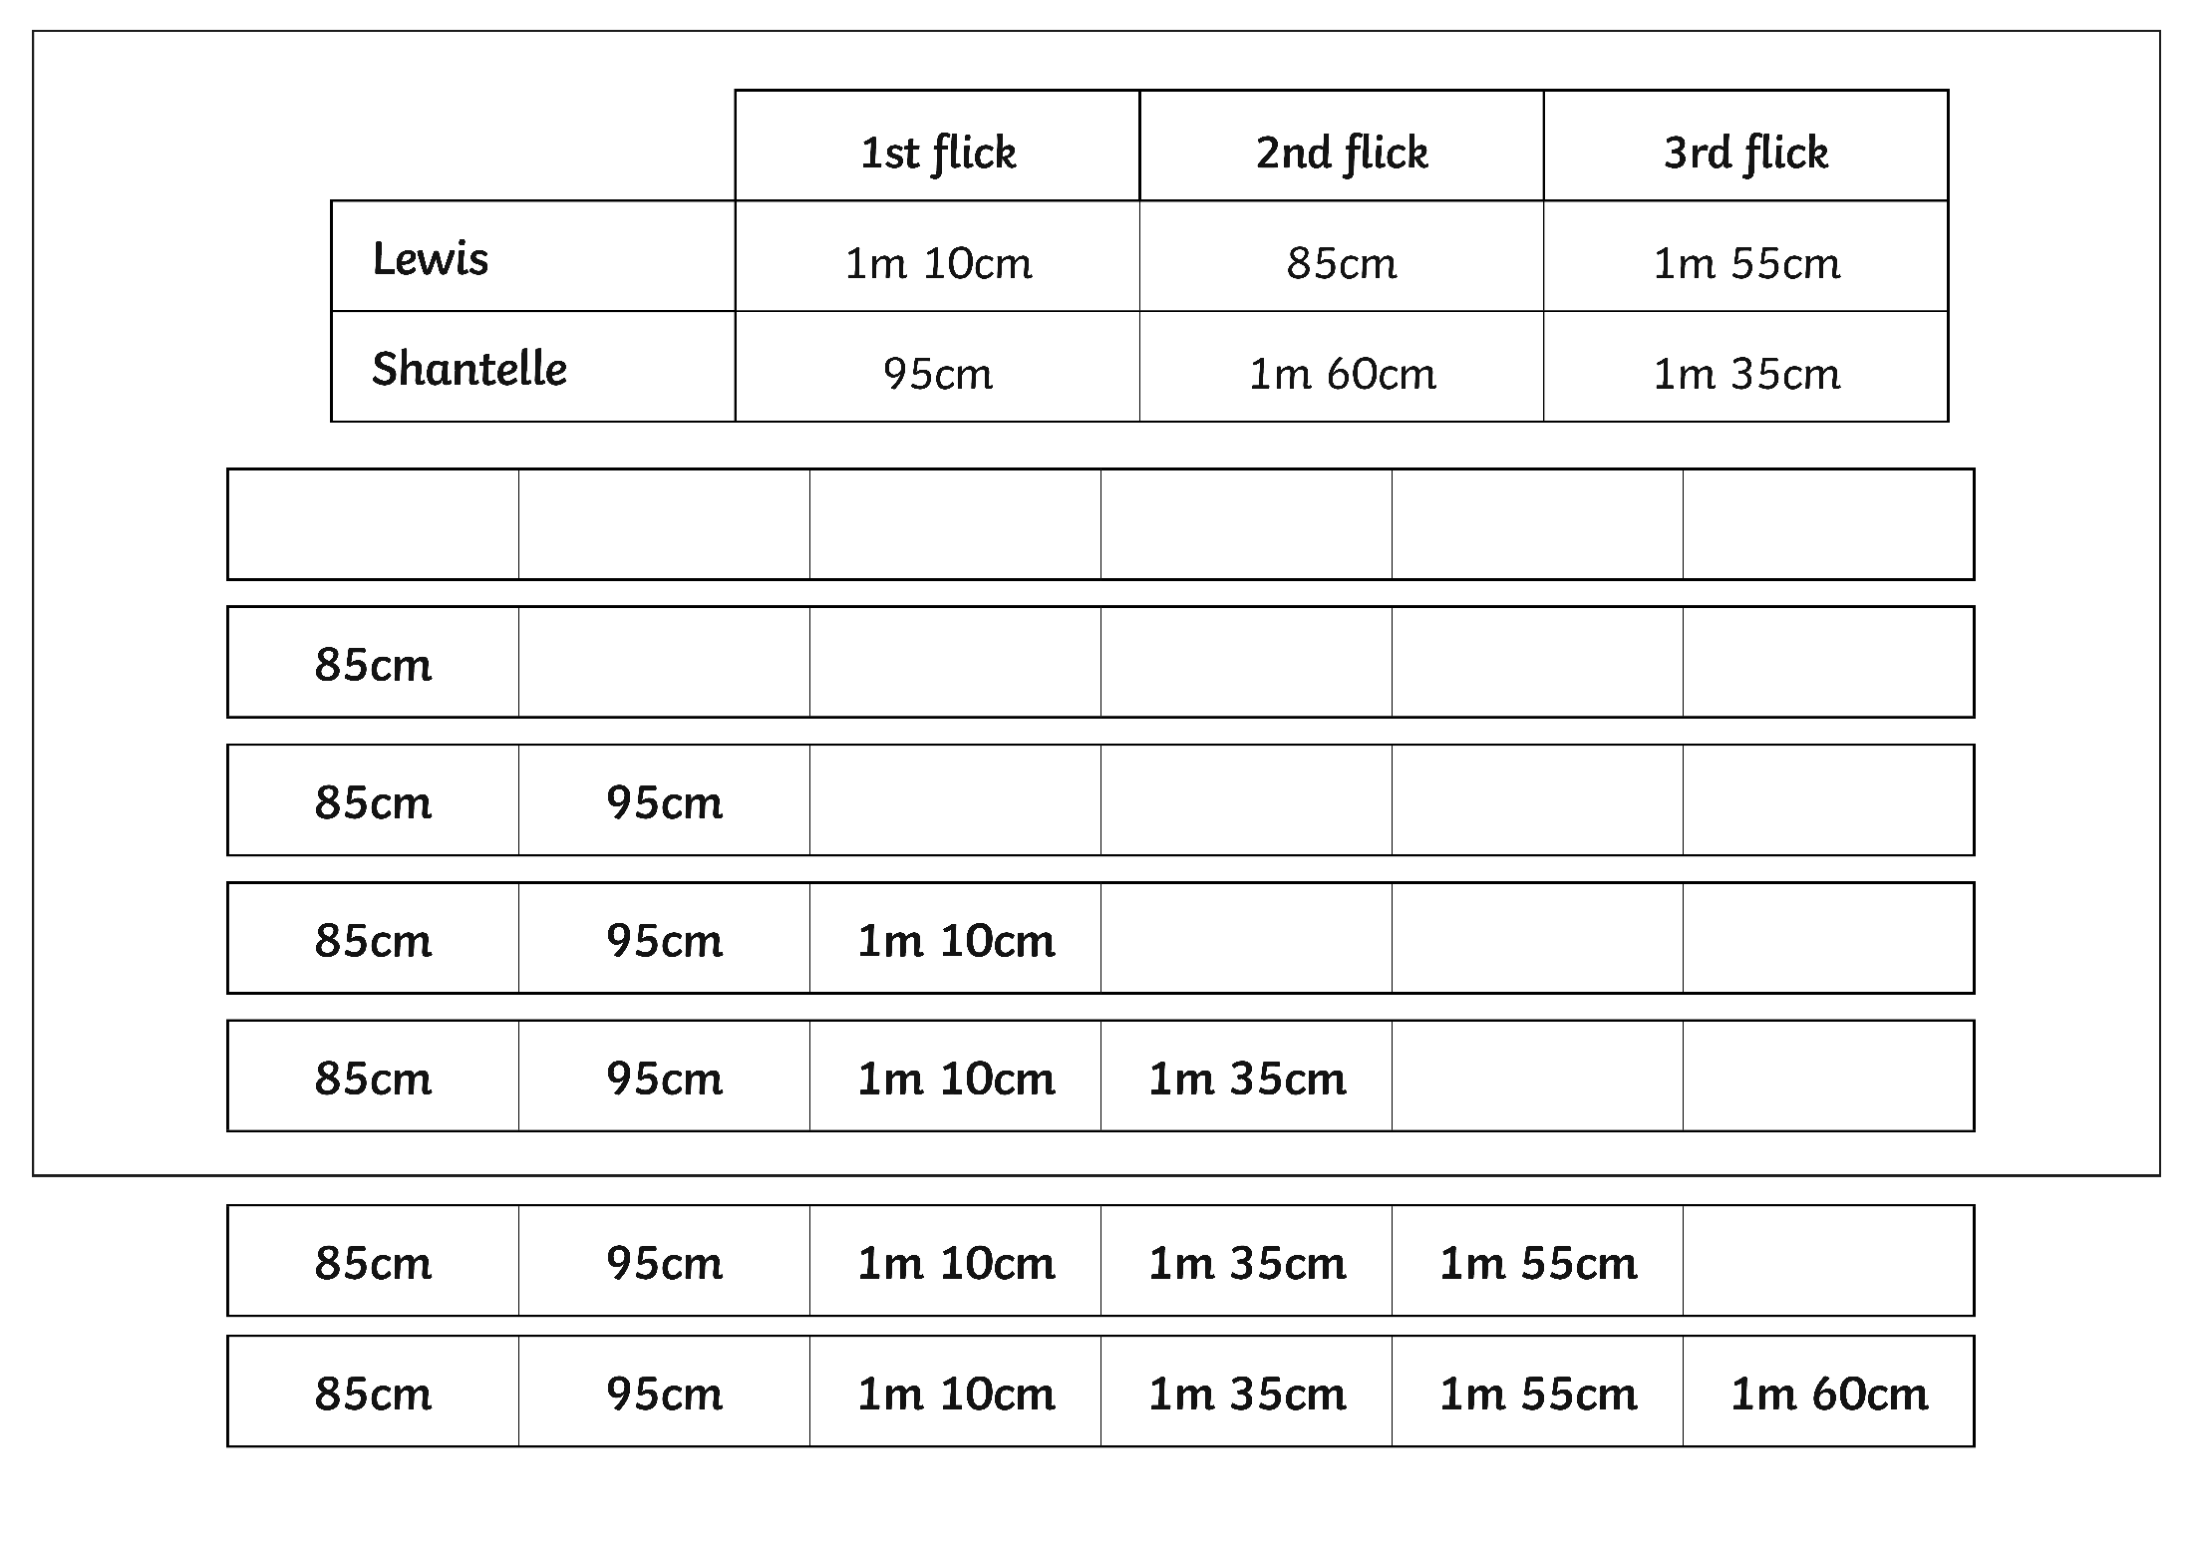

Mixed Unit Ordering
Order the 6 measurements from shortest to longest.

Slide 40

Aim
I can compare measurements in m, cm and mm.
Success Criteria
I can compare single-unit length measurements.
I can compare mixed-unit length measurements.

Slide 41


