Slide 2



Diving into Mastery Guidance for Educators
Each activity sheet is split into three sections, diving, deeper and deepest, which are represented by the following icons:
These carefully designed activities take your children through a learning journey, initially ensuring they are fluent with the key concept being taught; then applying this to a range of reasoning and problem-solving activities.
These sheets might not necessarily be used in a linear way. Some children might begin at the ‘Deeper’ section and in fact, others may ‘dive straight in’ to the ‘Deepest’ section if they have already mastered the skill and are applying this to show their depth of understanding.
Diving
Deeper
Deepest

Slide 3
Aim
Measure, compare, add and subtract: lengths (m/cm/mm); mass (kg/g); volume/capacity (l/ml).

Slide 4
Equivalent Lengths – m & cm
Diving
Calculate the missing measurements.
a
b
c
d
4m
5m
6m
4m 20cm
4m 70cm
5m 10cm
5m 80cm

Slide 5
Equivalent Lengths – m & cm
Diving
Complete the missing measurements.
cm | = | m
 | = | 1
300 | =
 | = | 4
800 | =
100
3
400
8

Slide 6

Equivalent Lengths – m & cm
Deeper
Complete the part-whole models.
130cm
245cm
30cm
1m
2m
45cm

Slide 7
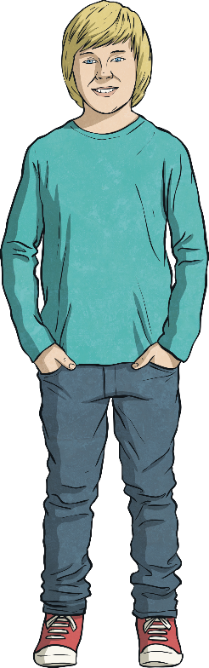
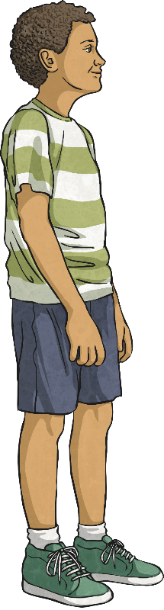
Equivalent Lengths – m & cm
Deeper
Jürgen and Samir are cutting pieces of ribbon.
My ribbon is 3m 50cm long.
My ribbon is 305cm long. It’s shorter than yours.
Who do you agree with? Give your reasons.
Samir is correct. 3m 50cm is equivalent to 350cm. 305cm is shorter than 350cm.
Jürgen
Samir

Slide 8
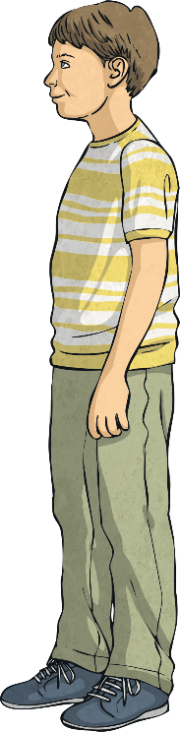
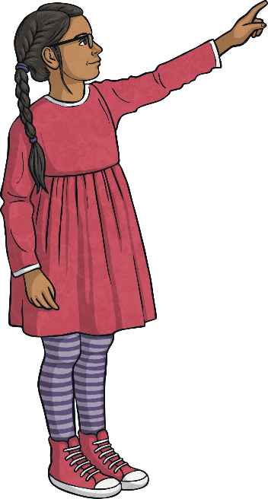
Equivalent Lengths – m & cm
Deeper
Margaret and Oliver are completing this part-whole model.
The missing numbers are 1 and 178.
The parts are 2 and 78.
278cm
m
cm
Both children are correct.
1m + 178 cm = 2m 78cm or 278cm
2m + 78cm = 2m 78cm or 278cm
Who do you agree with? Give your reasons.

Slide 9

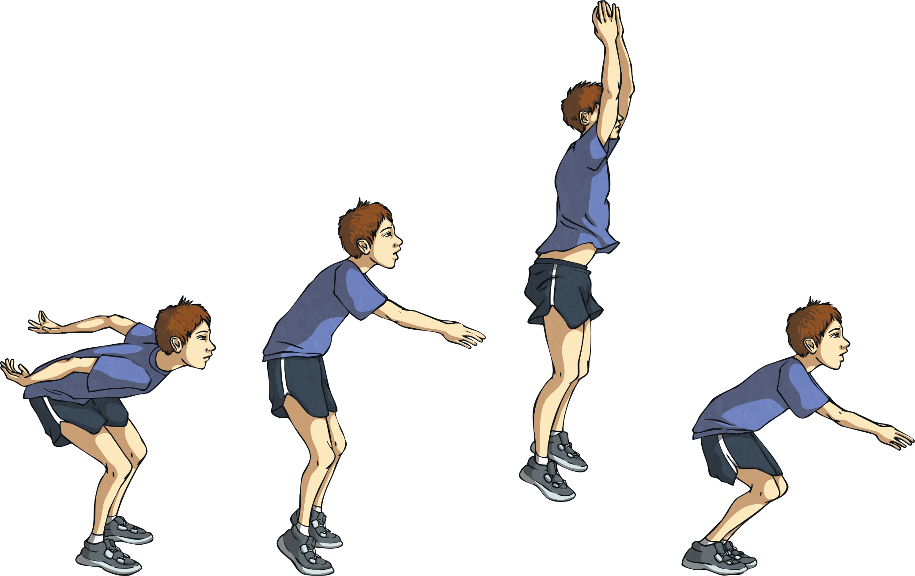
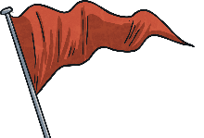
Equivalent Lengths – m & cm
Deepest
Grace, Jamil, Kristian and Parminder measured their jumps. Use the clues to work out who jumped each distance.
Parminder
I jumped 317cm.
Now write a clue for how far Grace jumped.
Jamil
I jumped less than 1m 50cm.
Kristian
I jumped 100cm more than 2m 71cm.
A
B
C
D
137cm | 371cm | 3m 17cm | 1m 73cm
jumped this far. | jumped this far. | jumped this far. | jumped this far.
Jamil
Kristian
Parminder
Grace

Slide 10
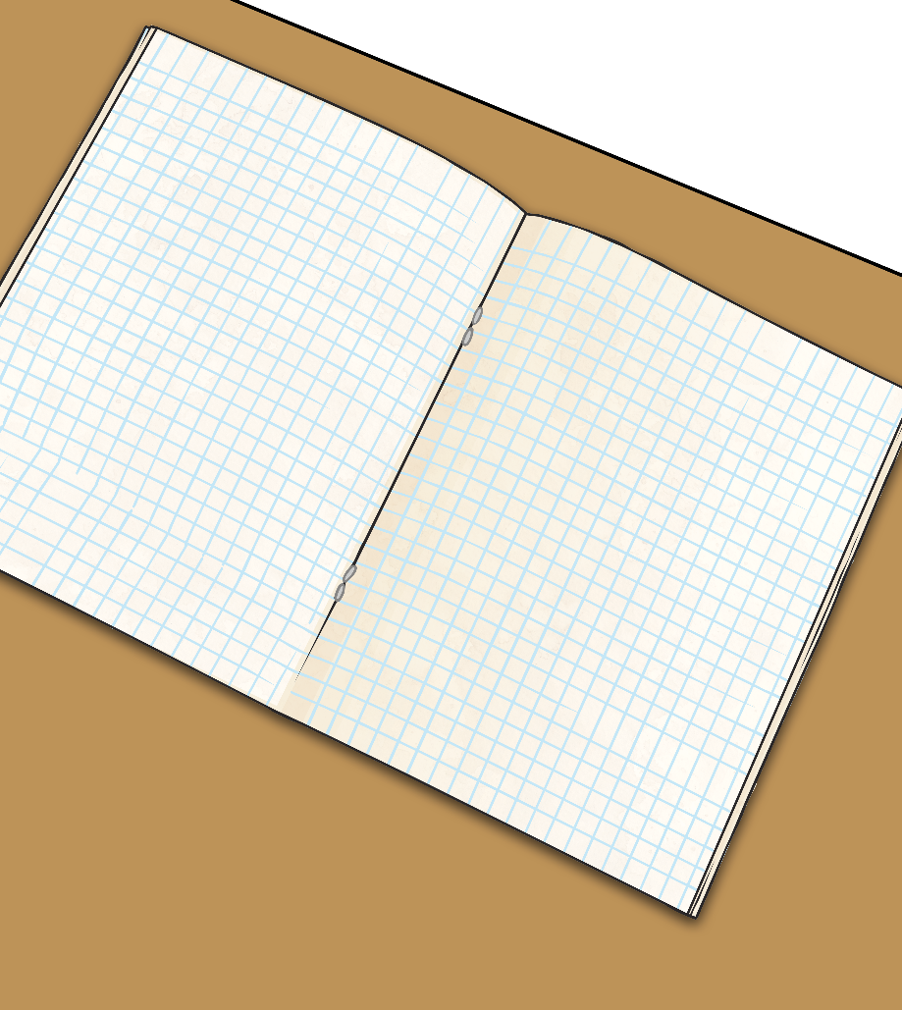
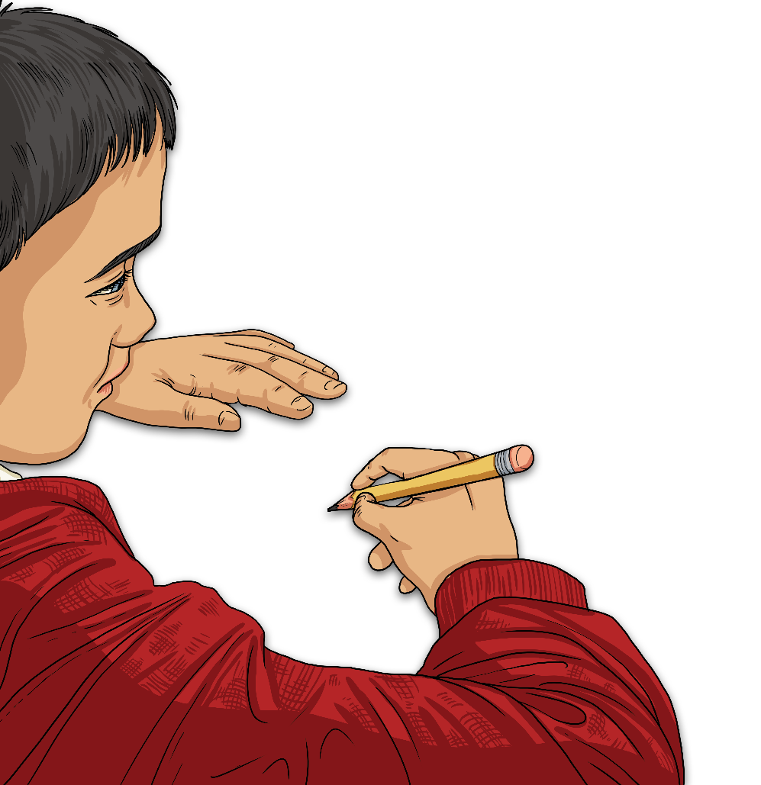
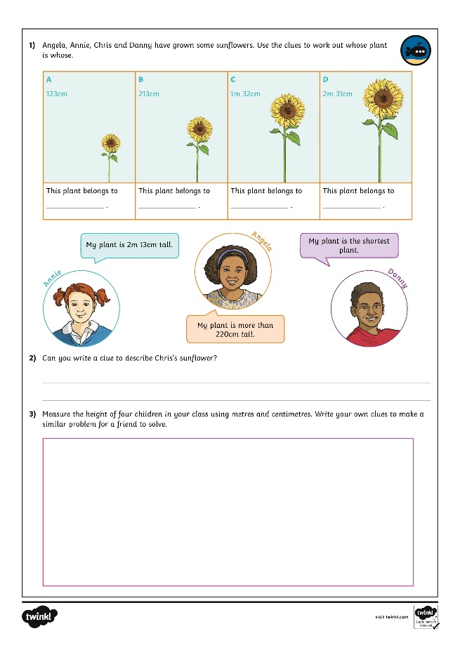
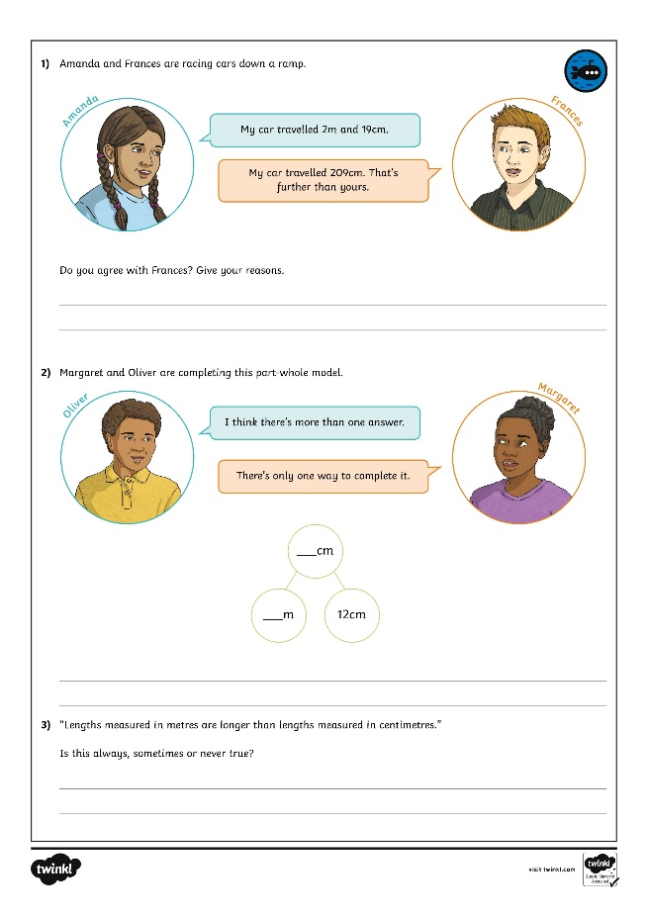
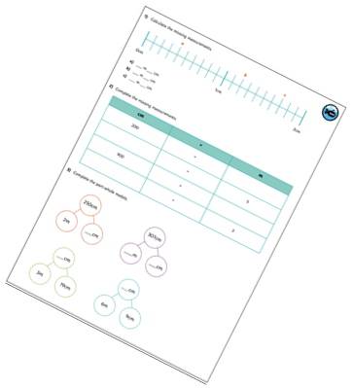
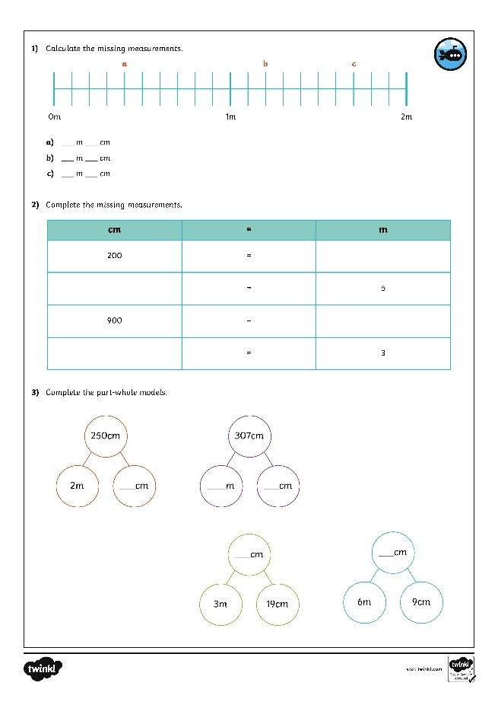
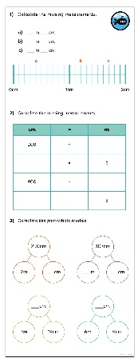
Equivalent Lengths – m & cm
Dive in by completing your own activity!

Slide 11
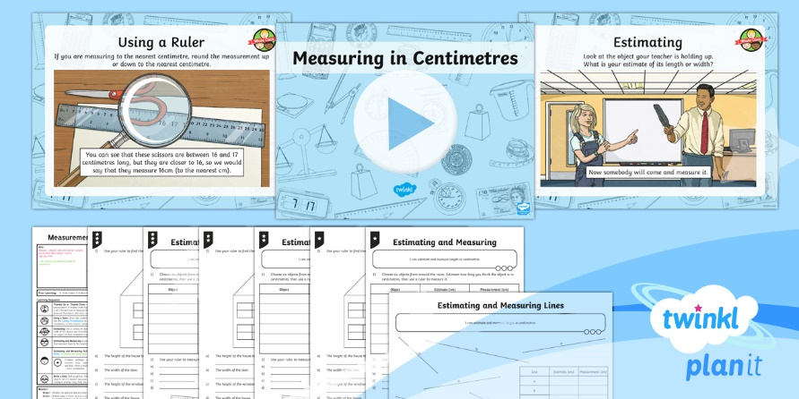
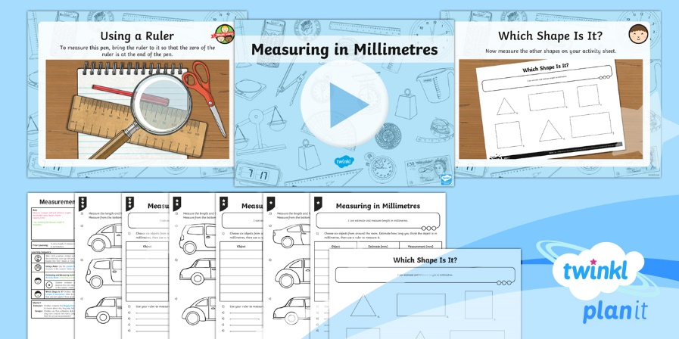

Need Planning to Complement this Resource?
National Curriculum Aim
Measure, compare, add and subtract: lengths; mass; volume/capacity.
For more planning resources to support this aim, click here.
Twinkl PlanIt is our award-winning scheme of work with over 4000 resources.

